Slide 1

A deformation order analysis tool for vehicle structures in crashworthiness design
Supervisors:
Volker Lange
Lailong Song
Students:
Moustafa Alsayed Ahmad
Jose Daniel Perez Ramirez
Massimo Sferza
Technische Universität München
Ingenieurfakultät Bau Geo Umwelt
Lehrstuhl für Computational Mechanics
7th July, 2016

Slide 2
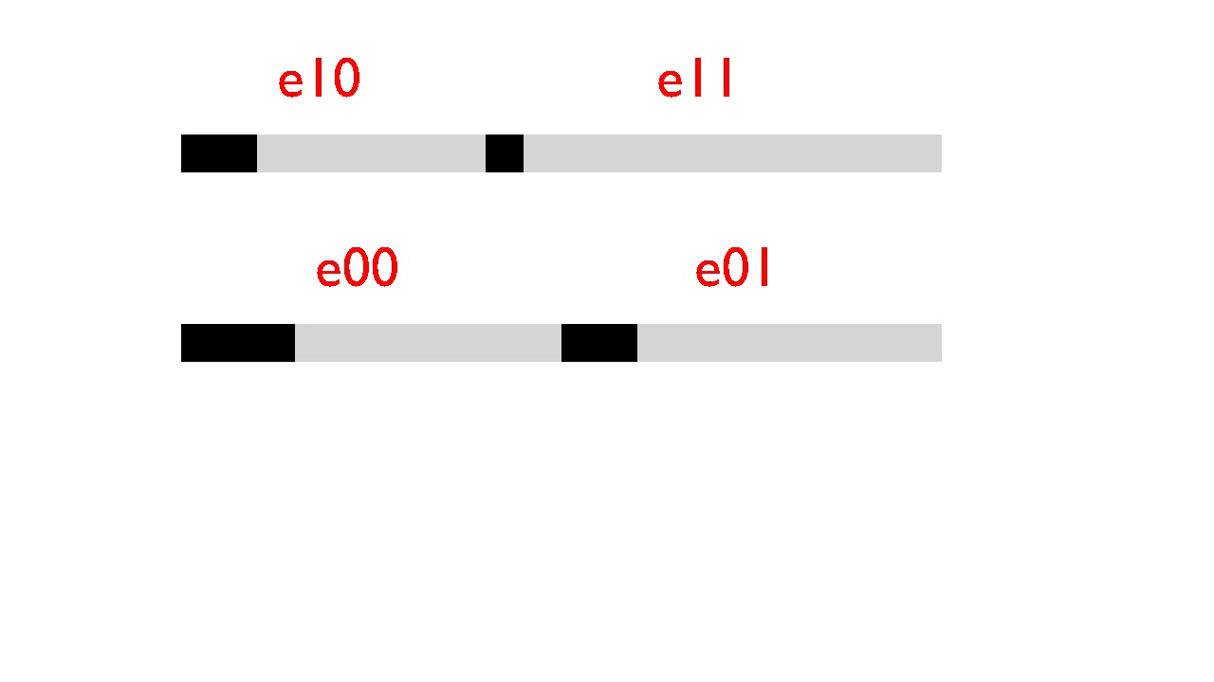
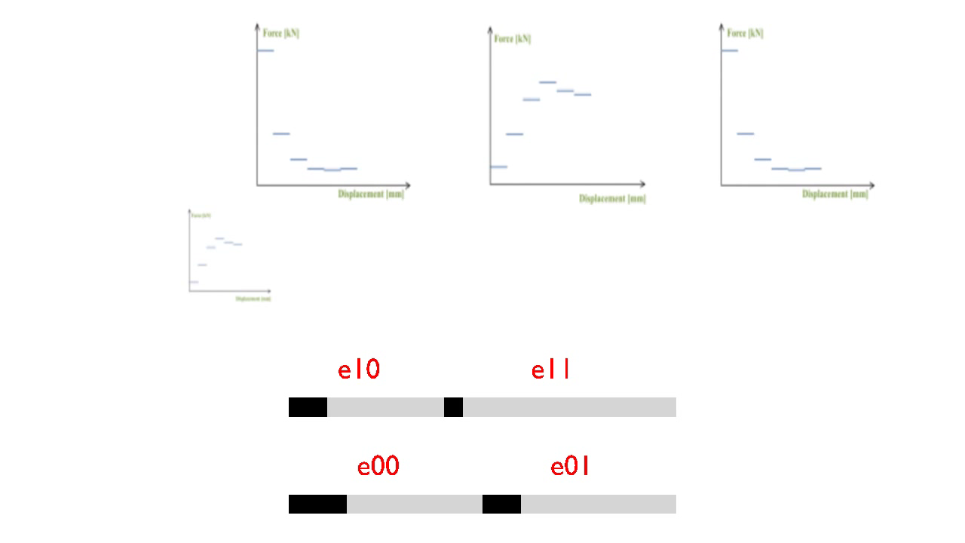
Our project
First task
Second task
Third task
Create movies

Slide 3
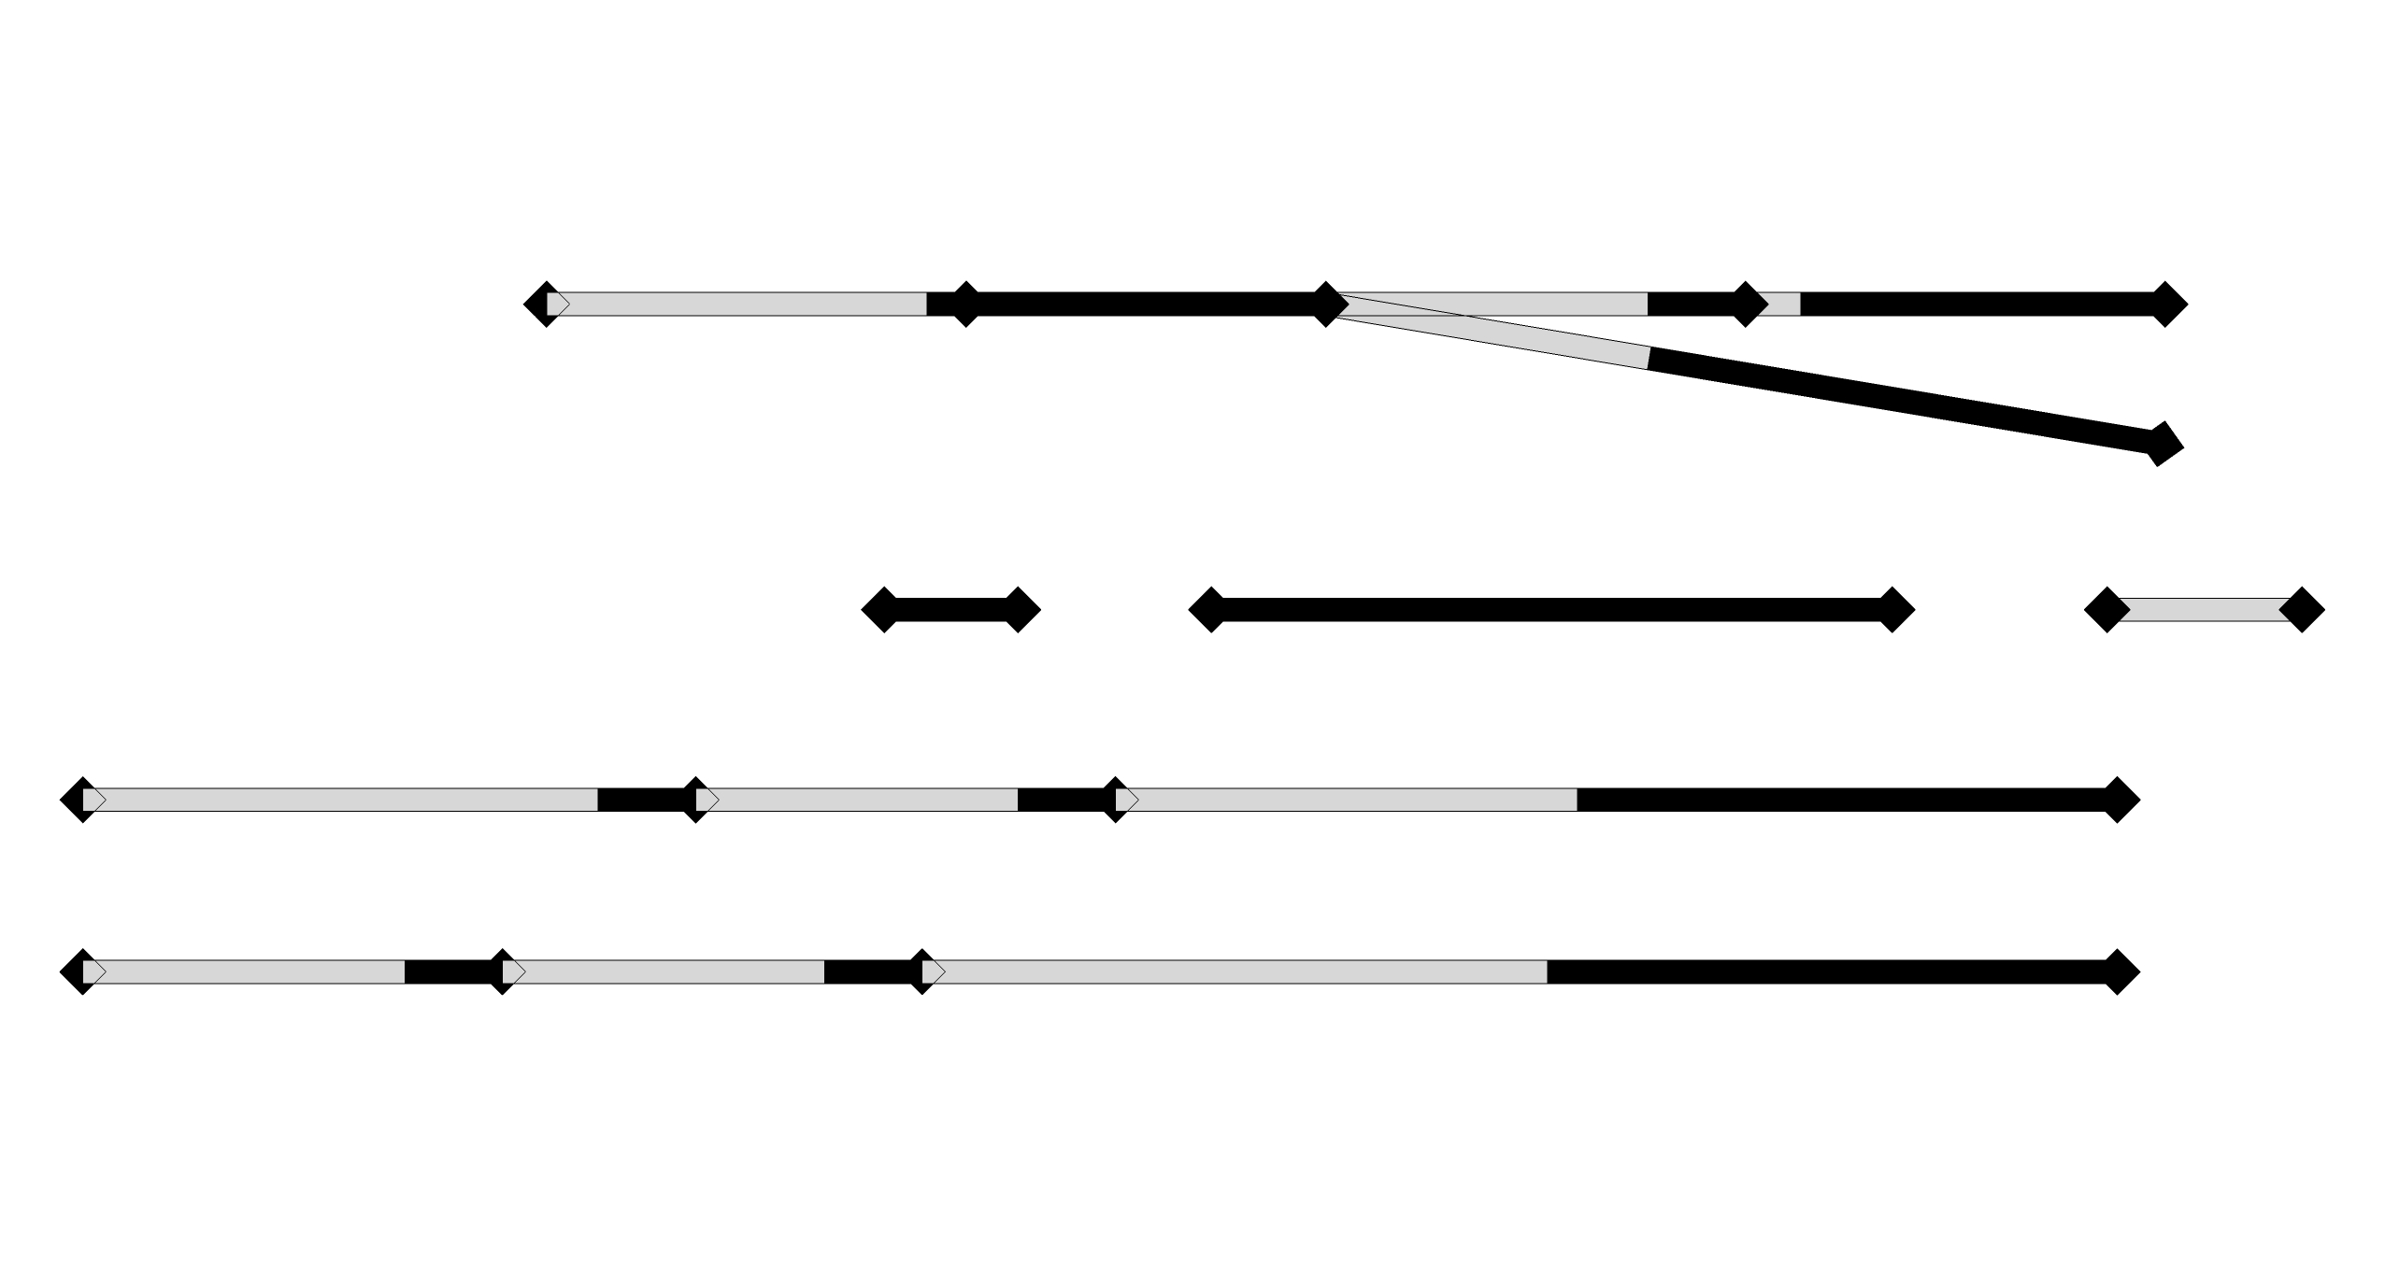
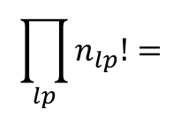
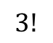
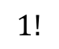
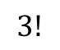
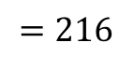
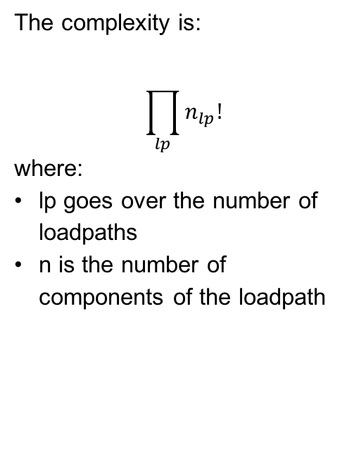
Q: “the complexity of the problem grows with the factorial of the number of components: is brute force a good approach?”
Therefore brute force is not a problem since our problems are simple enough.
But of course there are smarter ways to accomplish the task.
And we’re already working on one.
Let’s consider a possible structure.
In this case the number of possible solutions is:
The complexity is:
$$\prod_{lp}{n_{lp}!}$$
where:
lp goes over the number of loadpaths
n is the number of components of the loadpath
$$3!$$
$$\prod_{lp}{n_{lp}!}=$$
$$=216$$
$$1!$$
$$3!$$
$$3!$$

Slide 4
Solutions to task 1
New model assumptions
Exhaustive enumeration method
Recursive stepwise method

Slide 5
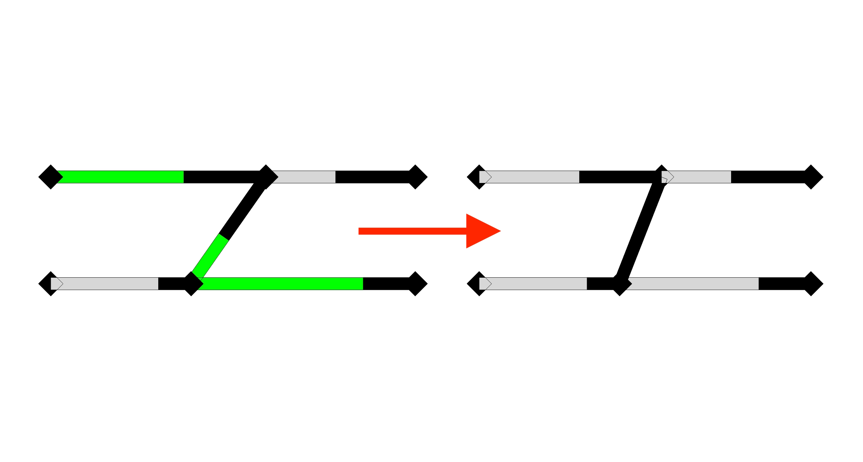
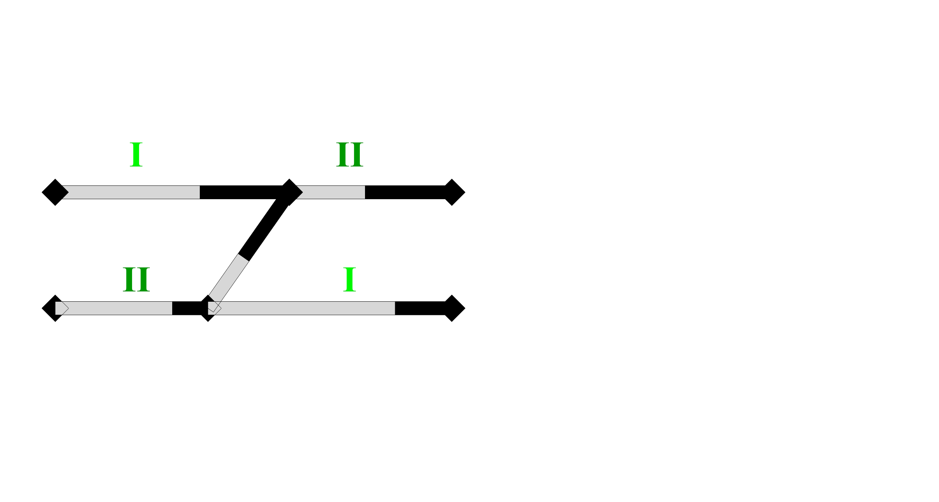
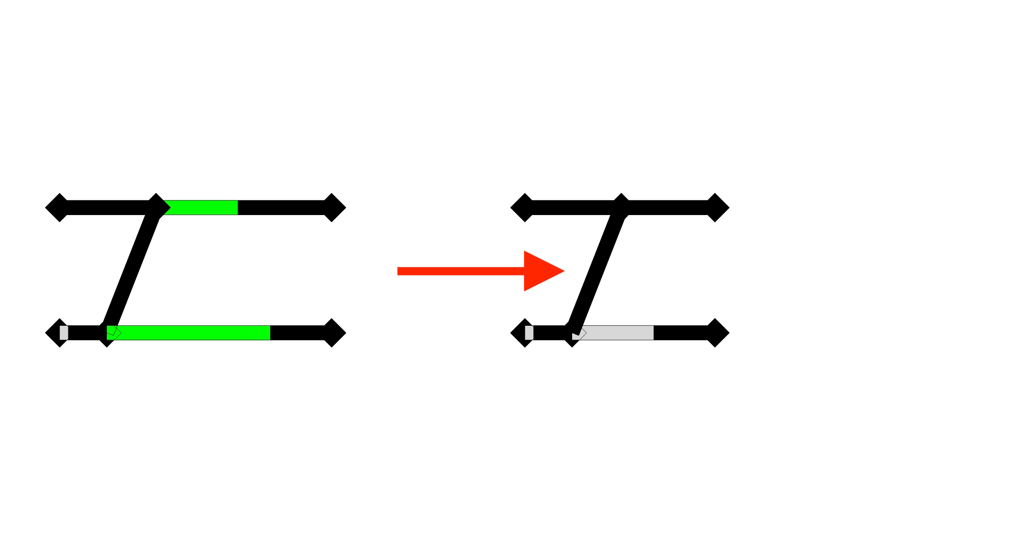
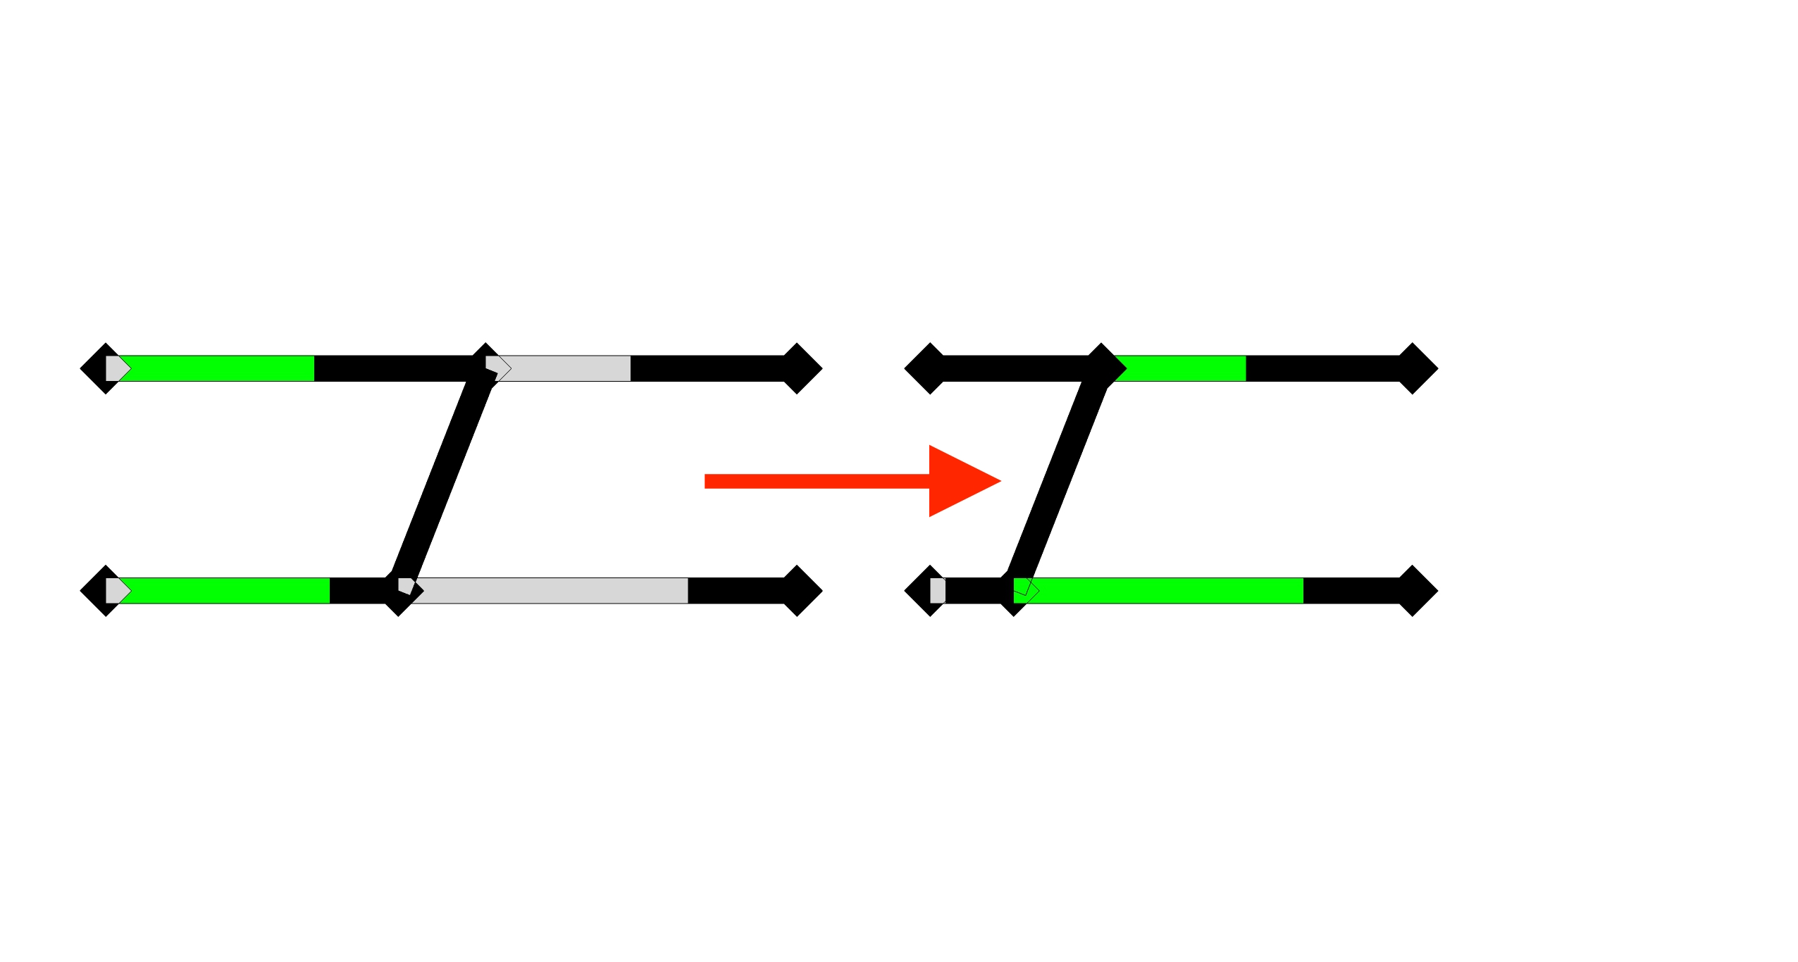
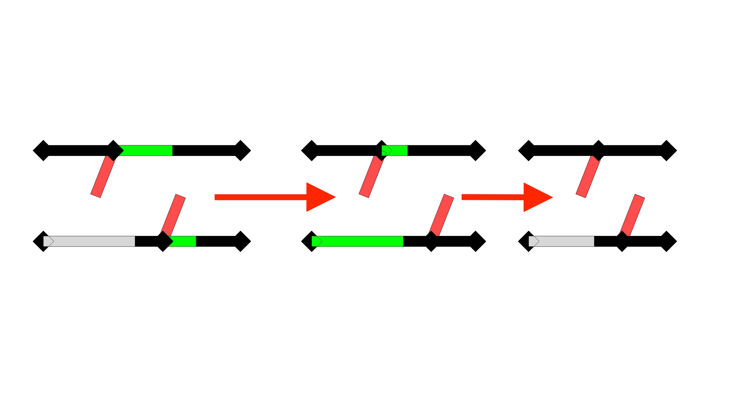
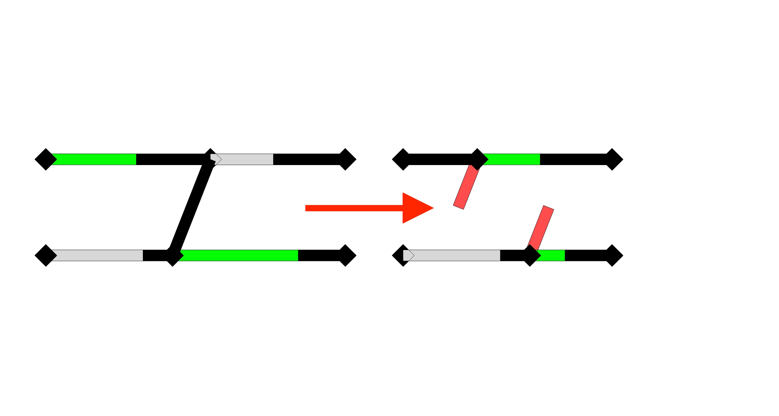
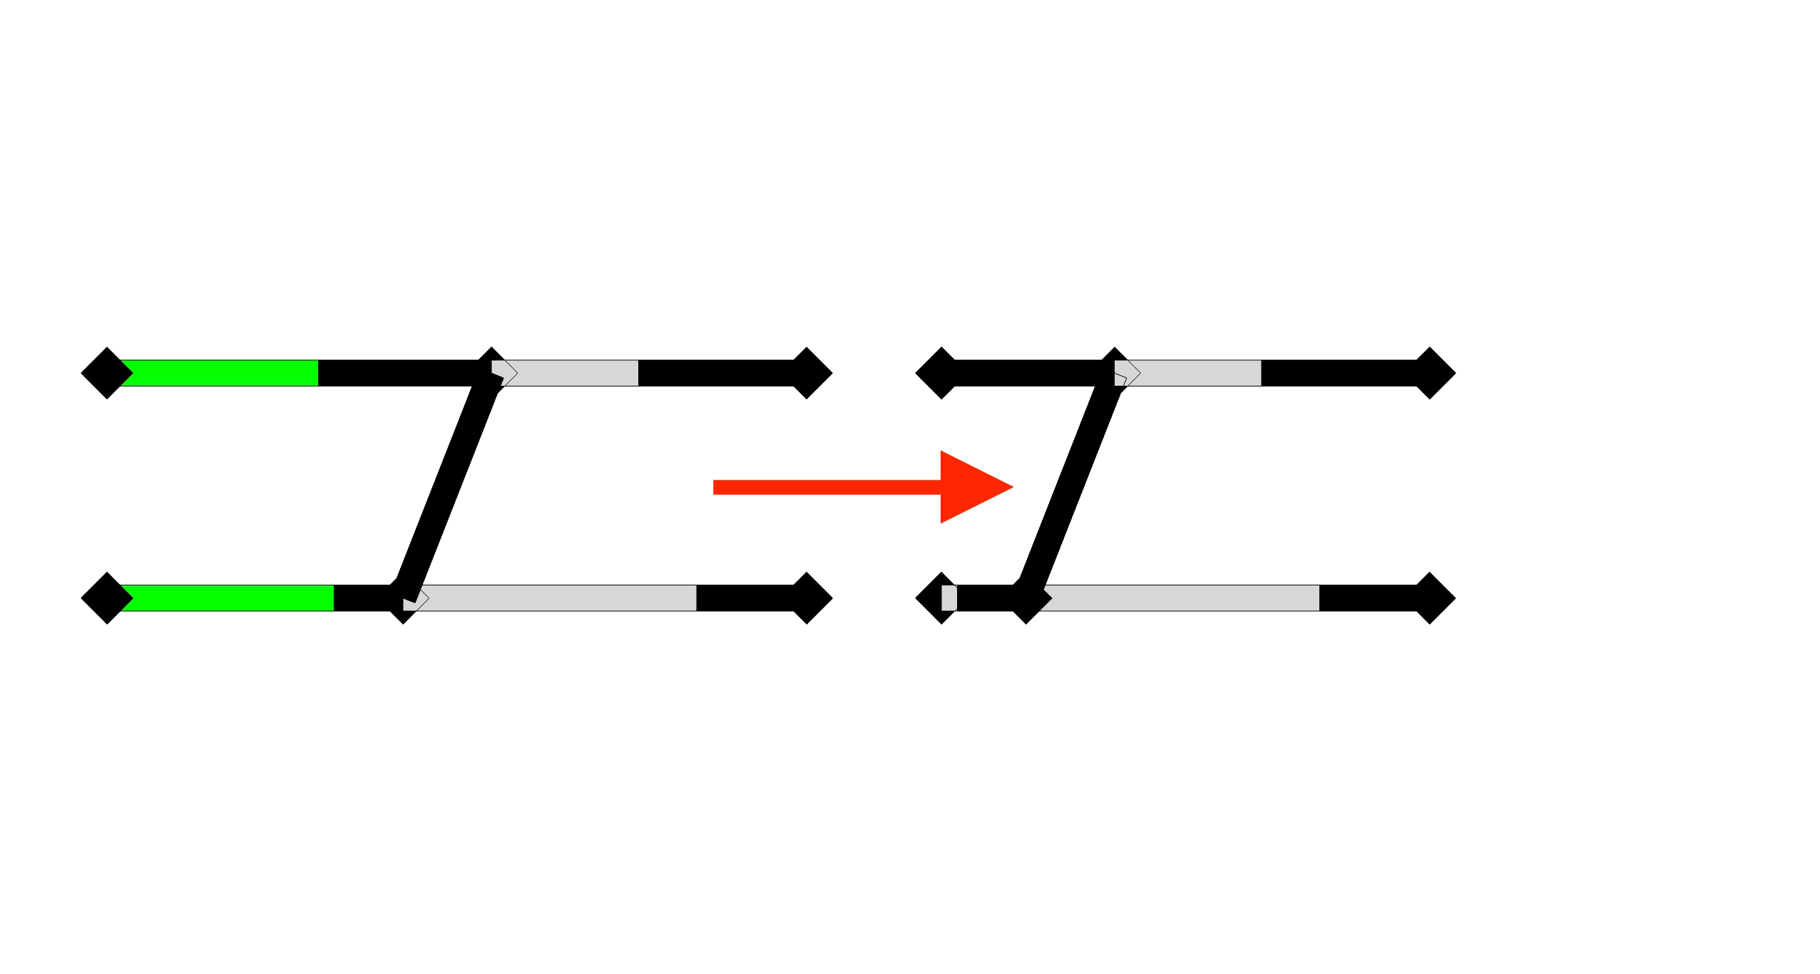
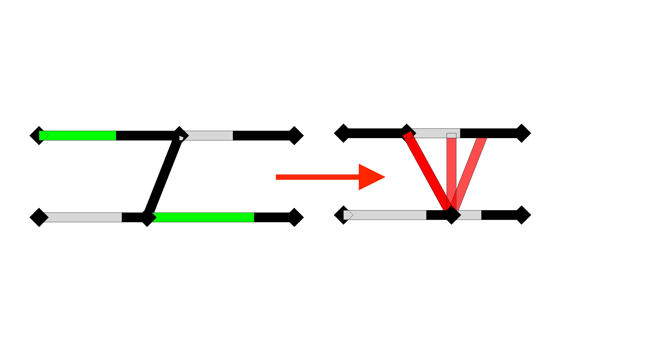
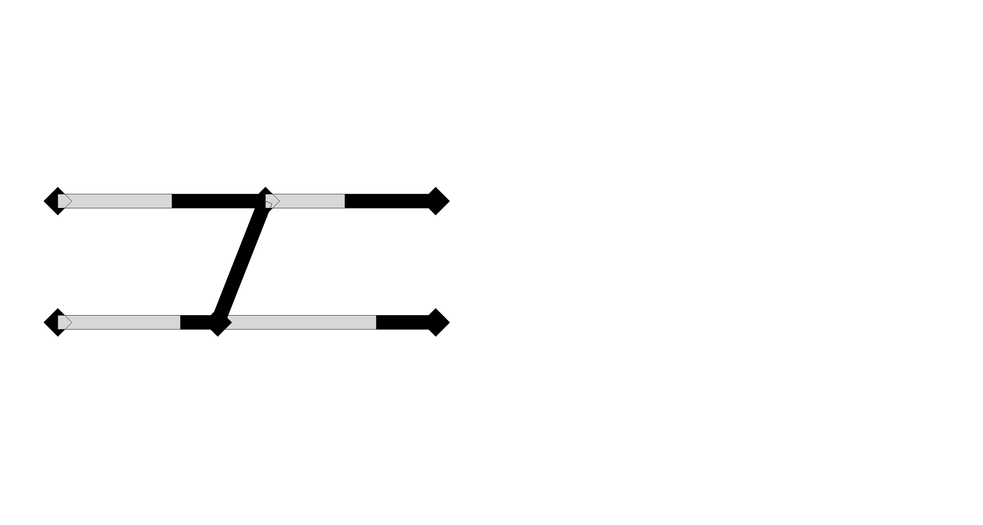
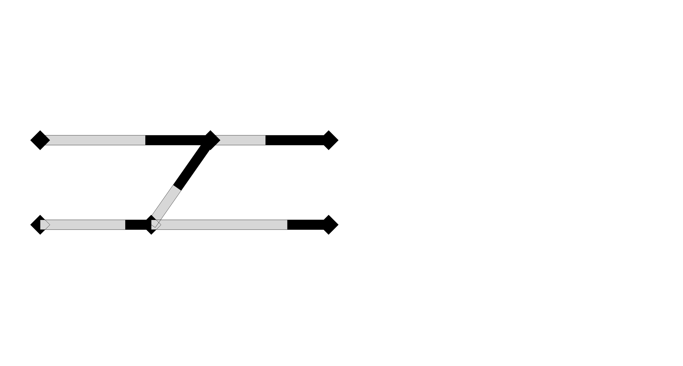
When did the previous assumptions fail?
New model assumptions
New proposed assumptions
STEP 1:
STEP 1: PERFORMED
Let’s consider a simple structure
and a particular order of deformation
Allow connections to break
Keep connections intact and allow member to deform twice
STEP 2 ?
STEP 2: DEADLOCK
4th possibility:
Deforming the stiffer members
3rd possibility:
Deforming the rear part
All the alternatives fail
Example: deforming the front part
Keep on deforming the same members
IS NOT POSSIBLE!
COMPONENTS DEFORM ONLY ONCE
RIGID COMPONENTS CAN’T DEFORM

Slide 6
Solutions to task 1
New model assumptions
Exhaustive enumeration method
Recursive stepwise method

Slide 7
Versions of the method
Exhaustive enumeration method
OLD ASSUMPTIONS: components can deform only once
Pre-computing all the possible solutions
Select elements to deform
NEW ASSUMPTIONS: components can deform more than once
Pre-computing all the possible solutions
Select directly elements to deform
Test the current deformation step
Select elements to deform OR discard solution
Save a solution when the structure is completely deformed

Slide 8
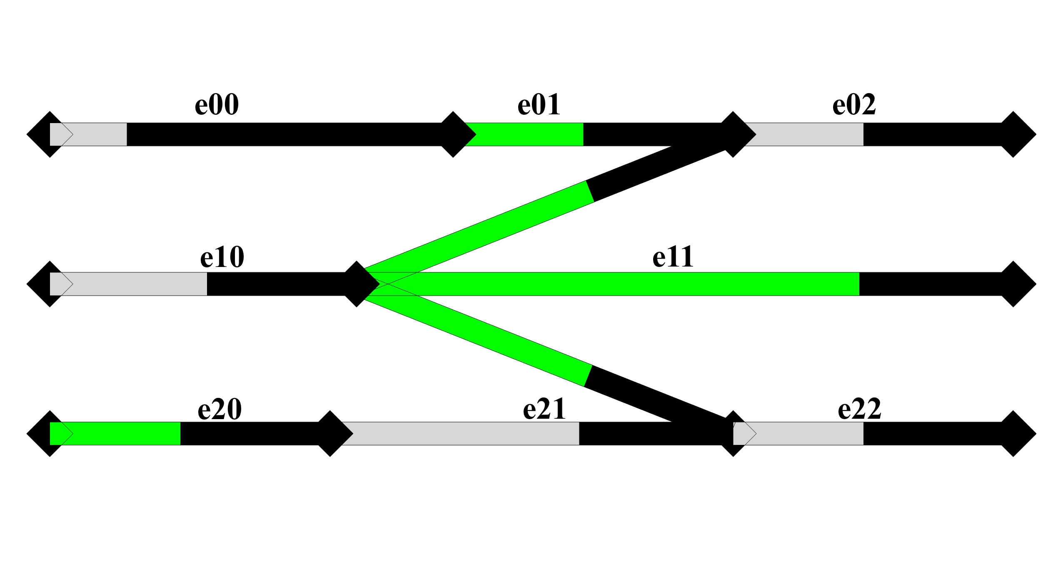
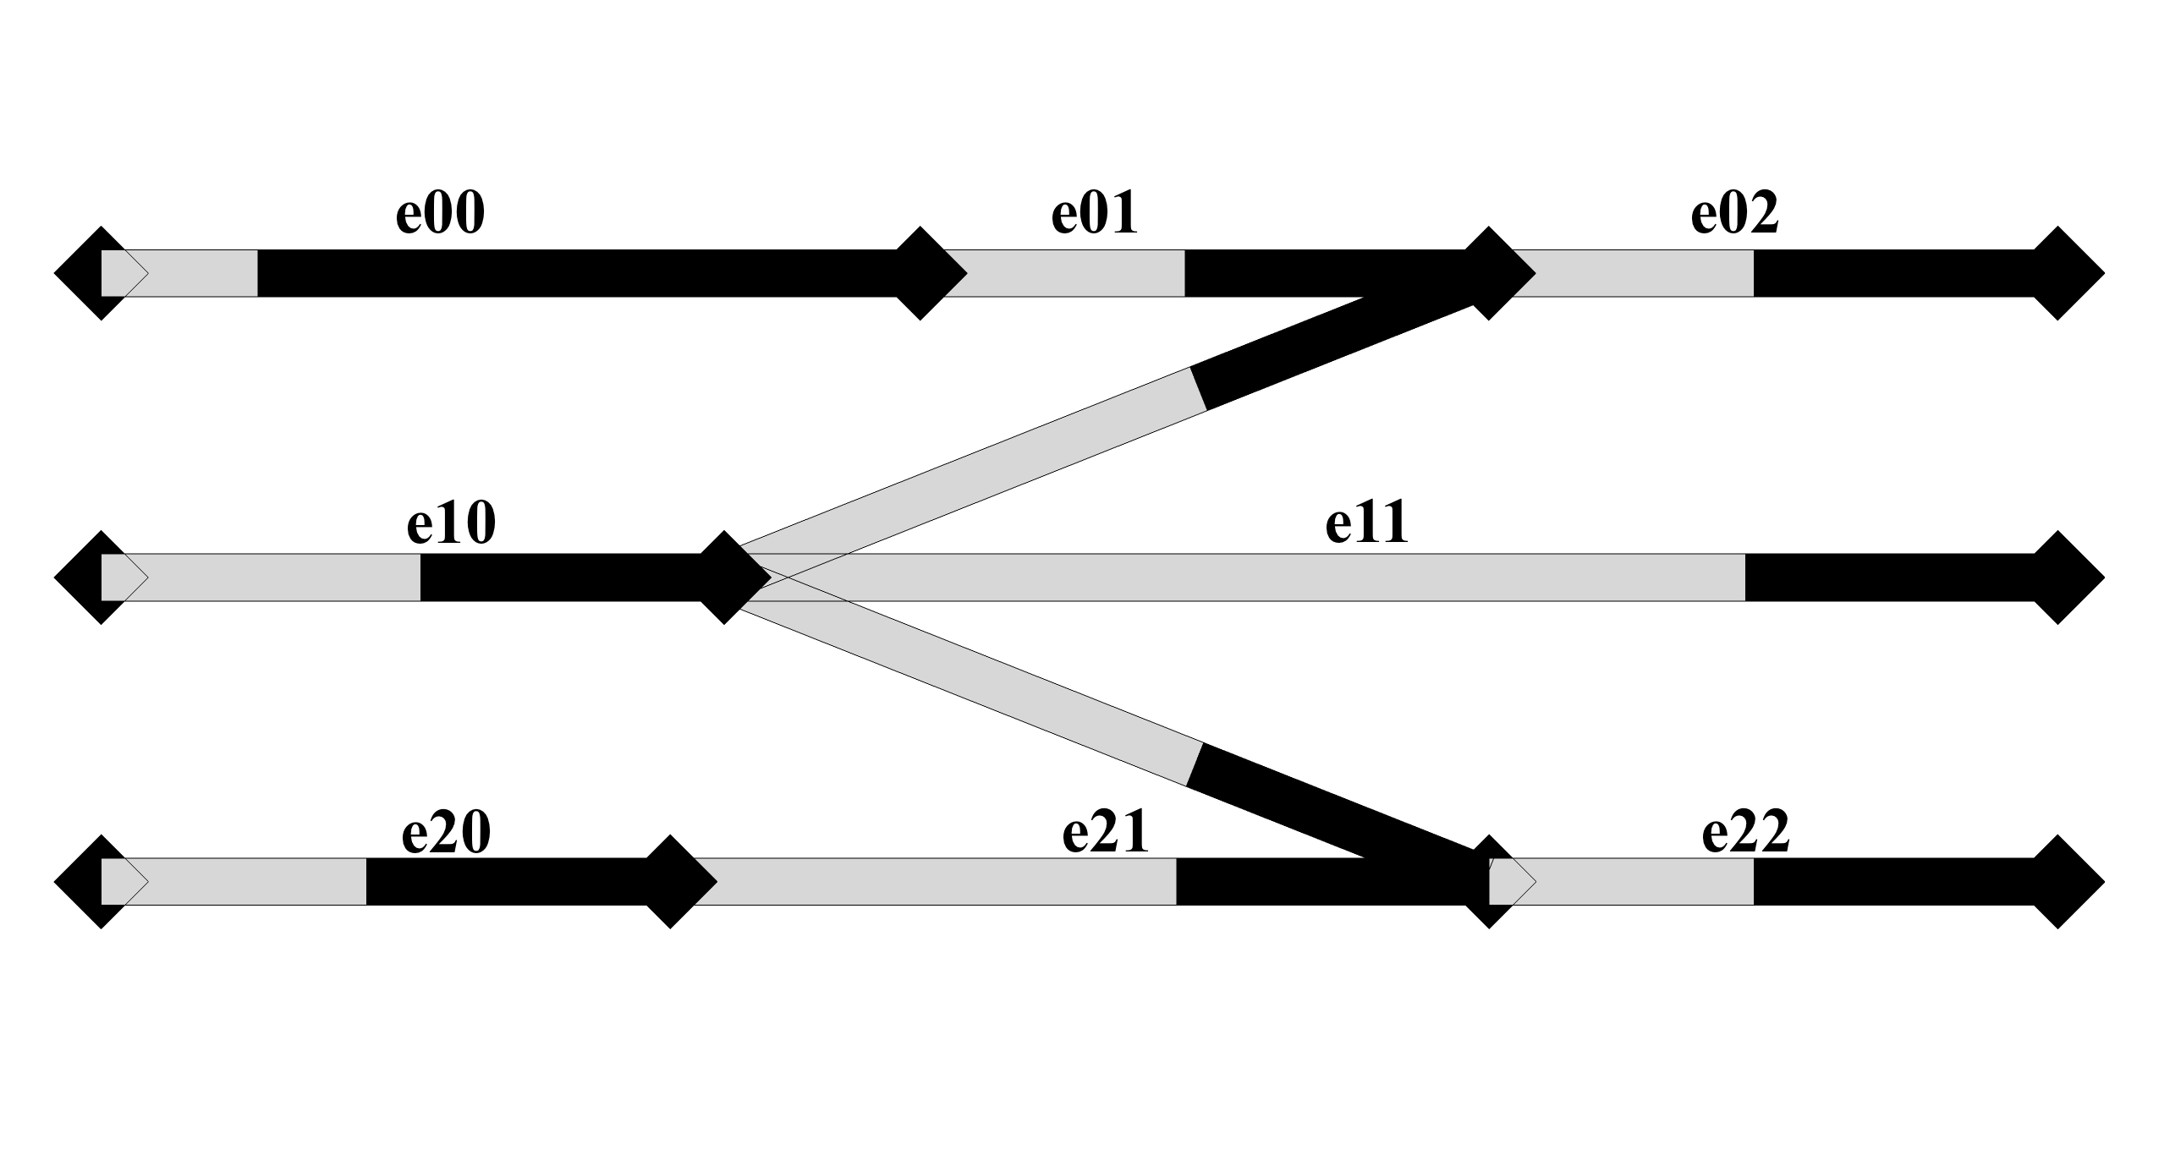
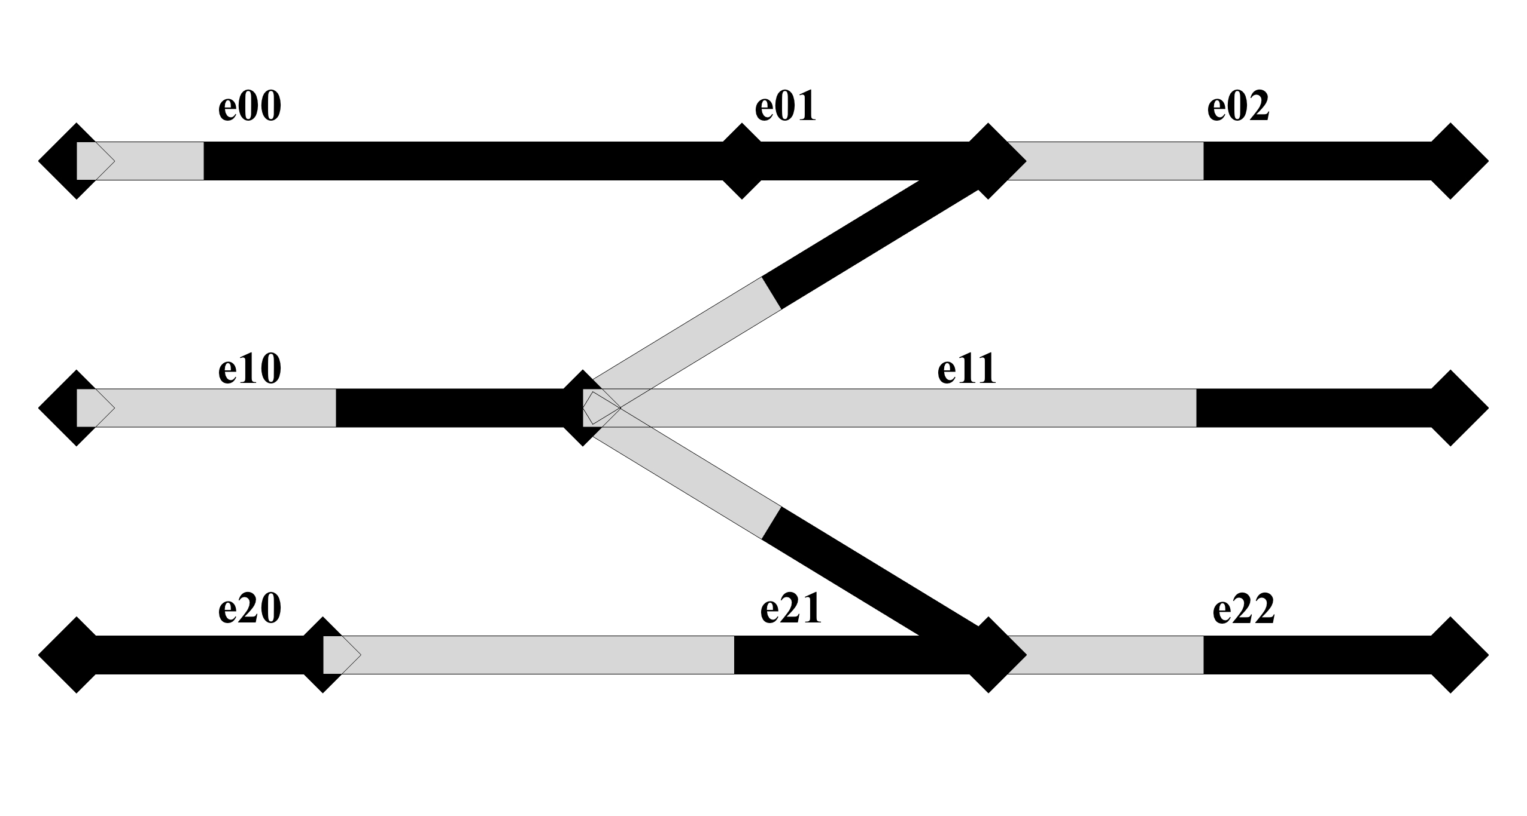
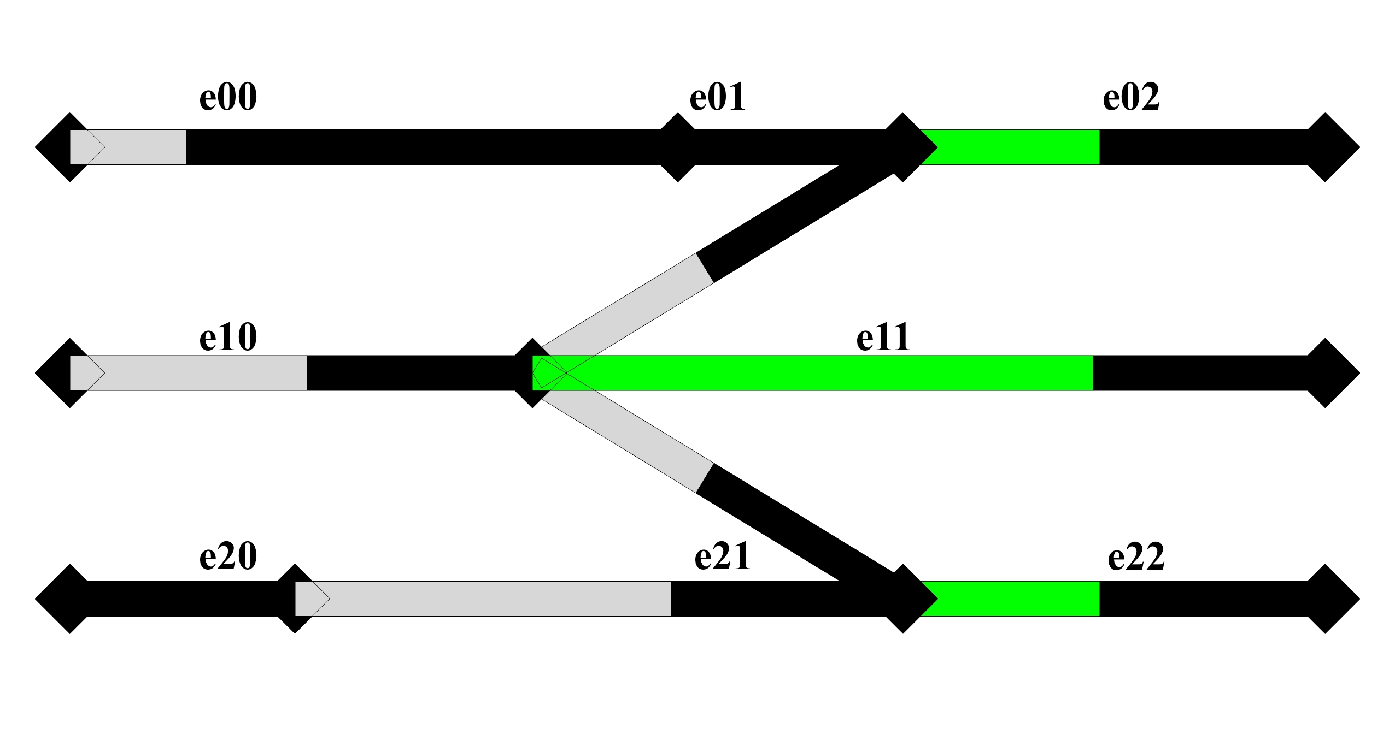
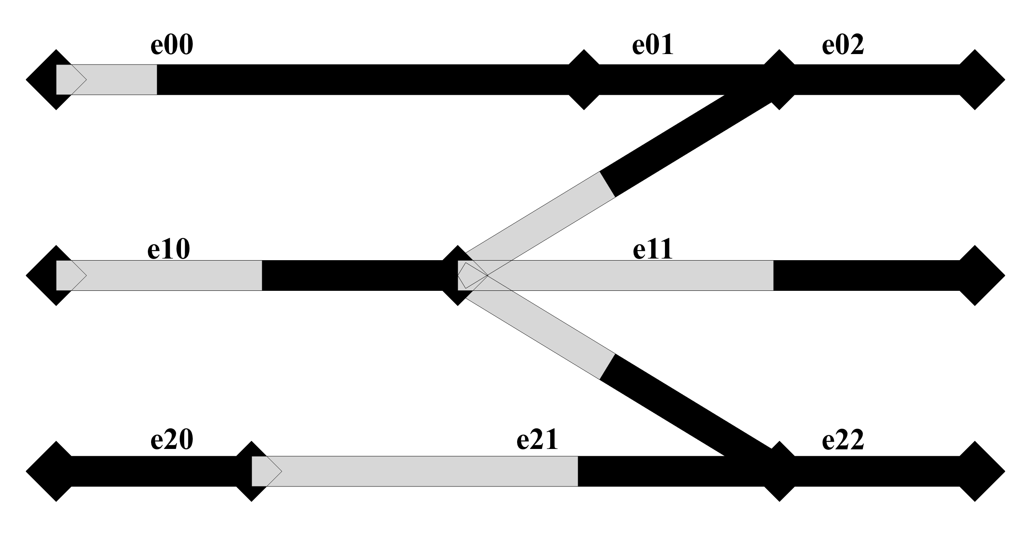
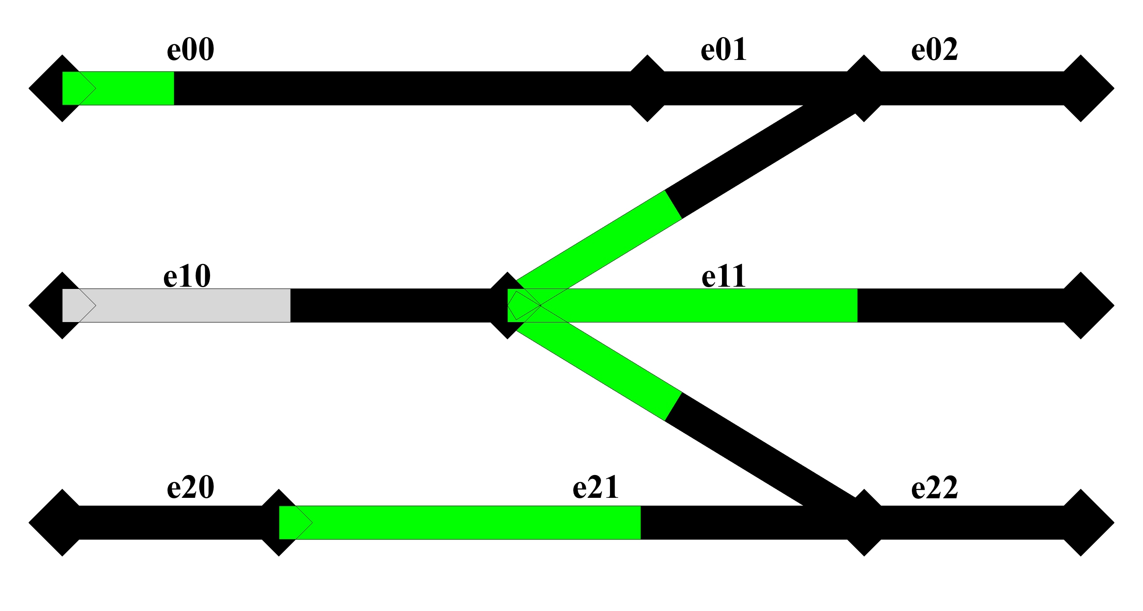
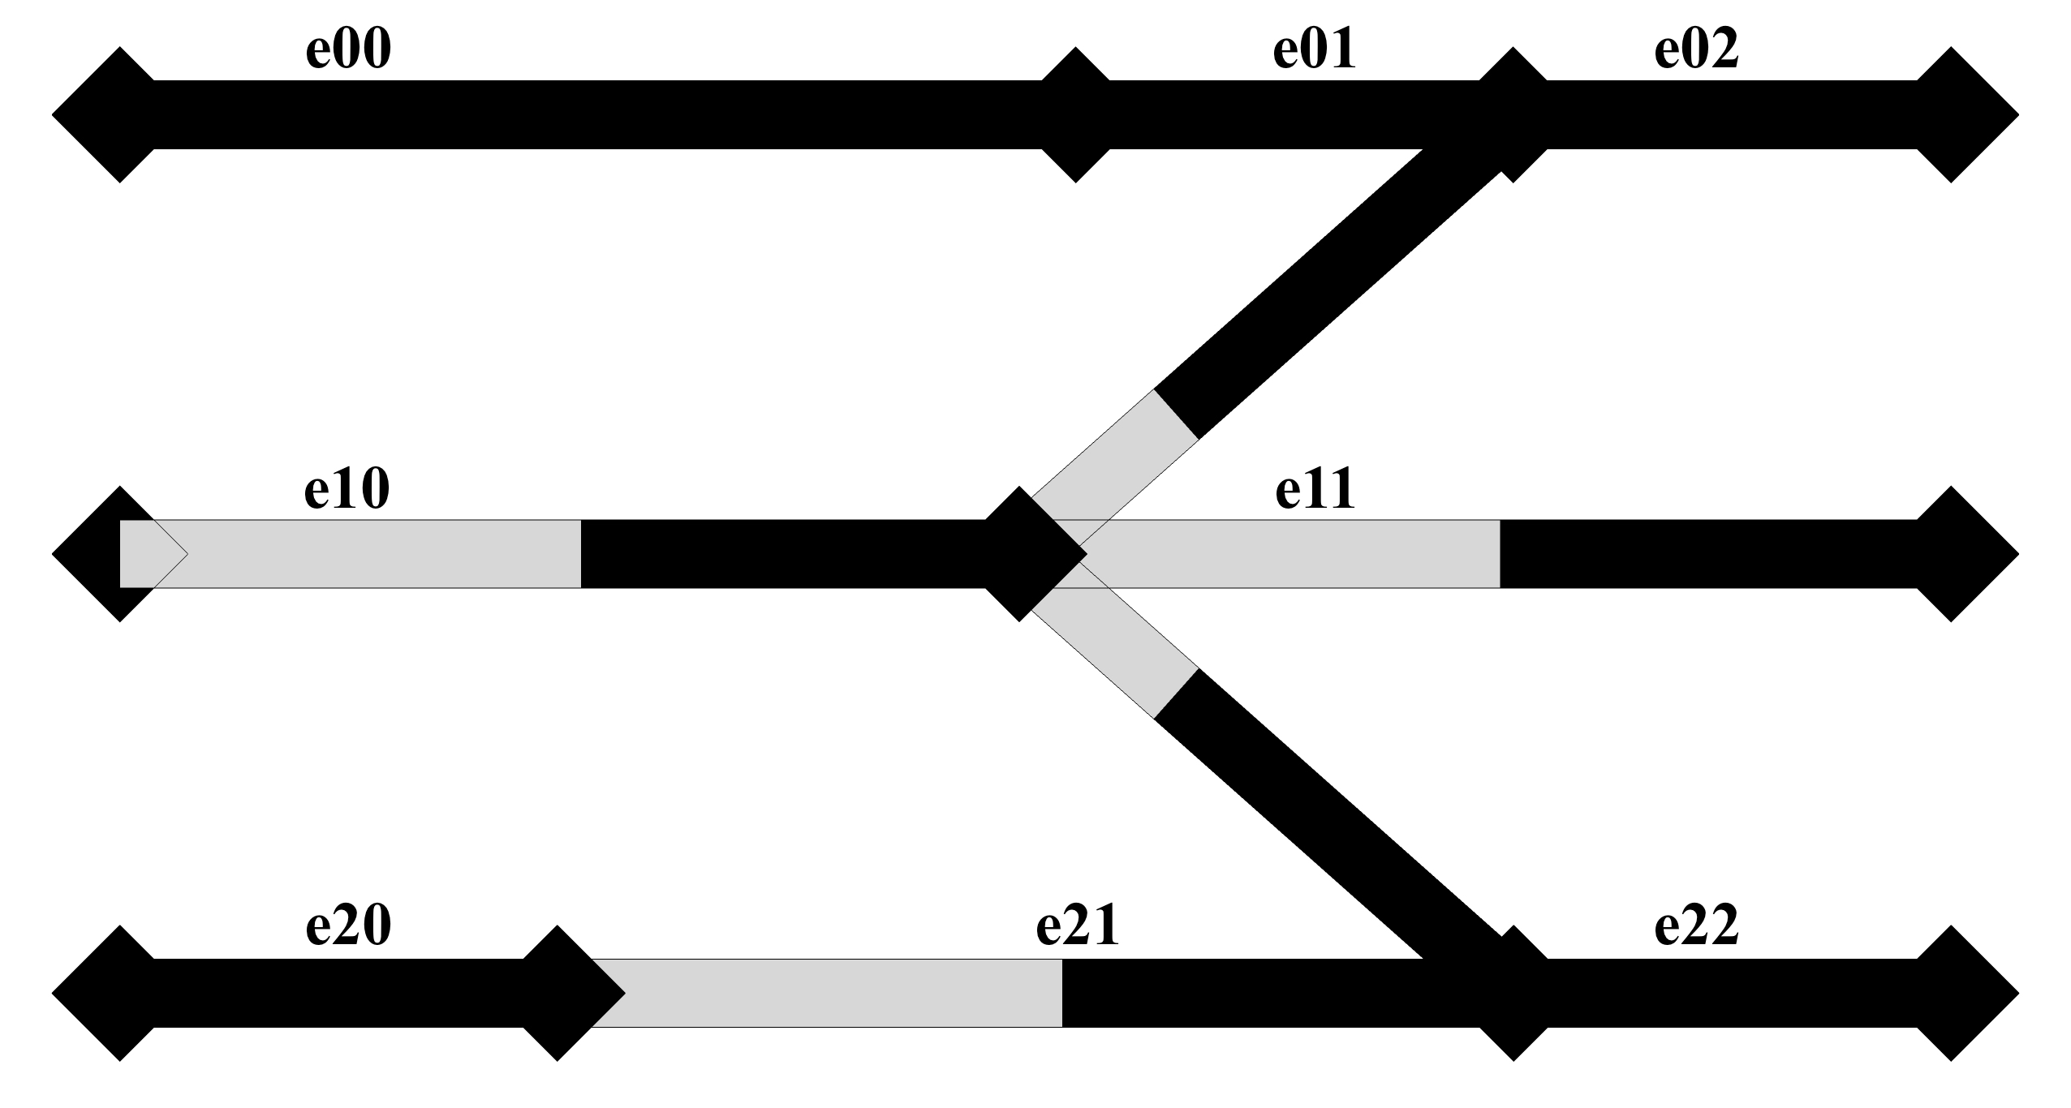
REVIEW OF OLD VERSION
Exhaustive enumeration method
Pre-computing all the solutions
Test each solution
e.g: solution 24:
[ e01, e02, e00 ]
[ e11, e10 ]
[ e20, e22, e21 ]
e.g: solution 24:
[ e02, e00 ]
[ e11, e10 ]
[ e22, e21 ]
e.g: solution 24:
[ e00 ]
[ e11, e10 ]
[ e21 ]
e.g: solution 24:
[ ]
[ e11, e10 ]
[ e21 ]
ELEMENTS TO DEFORM

Slide 9
NEW VERSION (work in progress)
Exhaustive enumeration method
Select directly the elements to deform
How to choose the elements to deform?
How to ensure that all the solutions will be considered?
e01
e11
e20
e11
ELEMENTS TO DEFORM

Slide 10
Solutions to task 1
New model assumptions
Exhaustive enumeration method
Recursive stepwise method

Slide 11
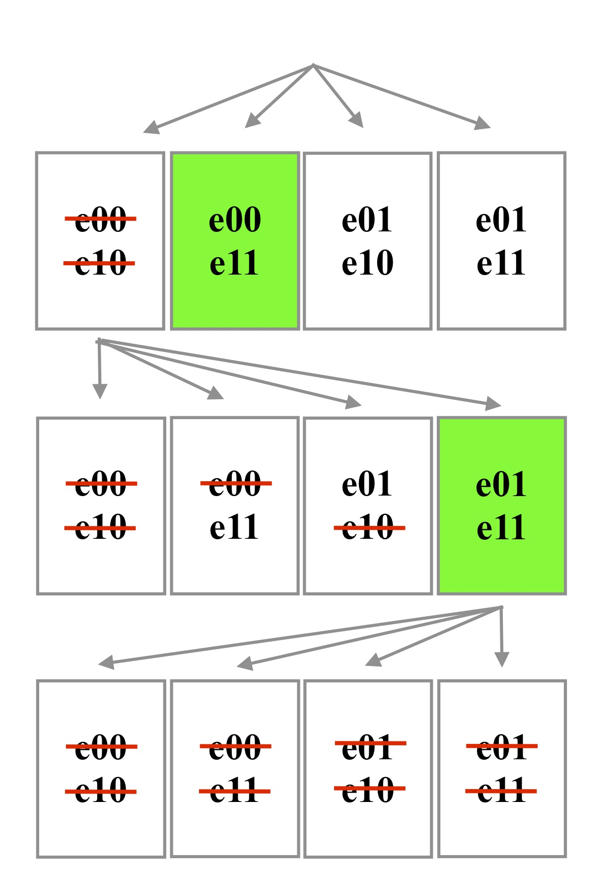
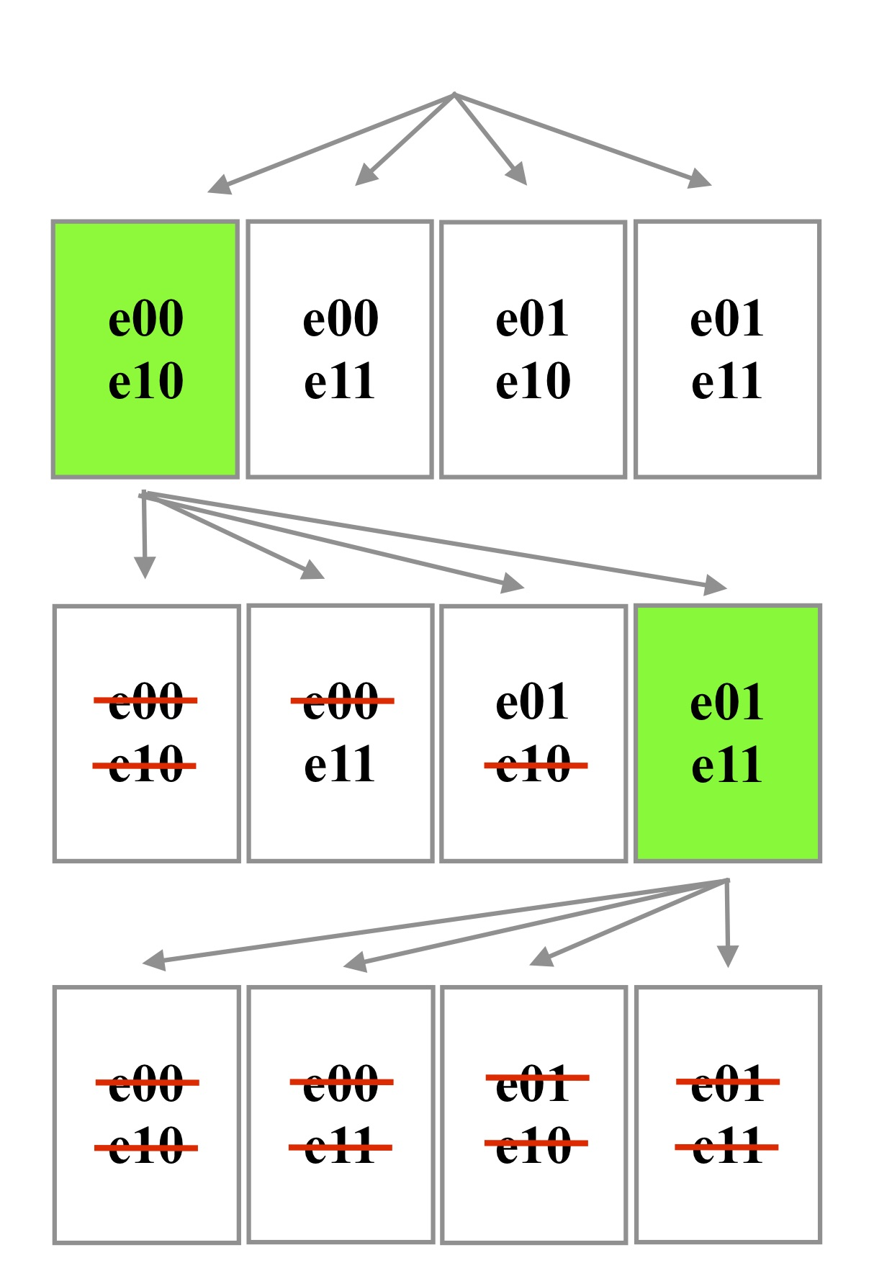
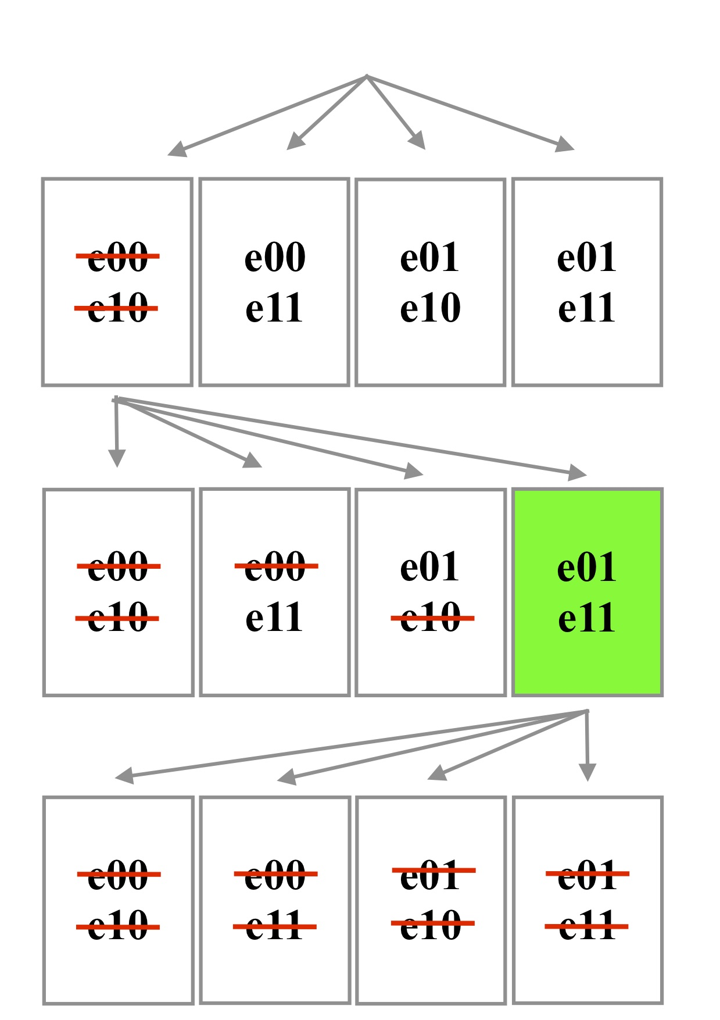
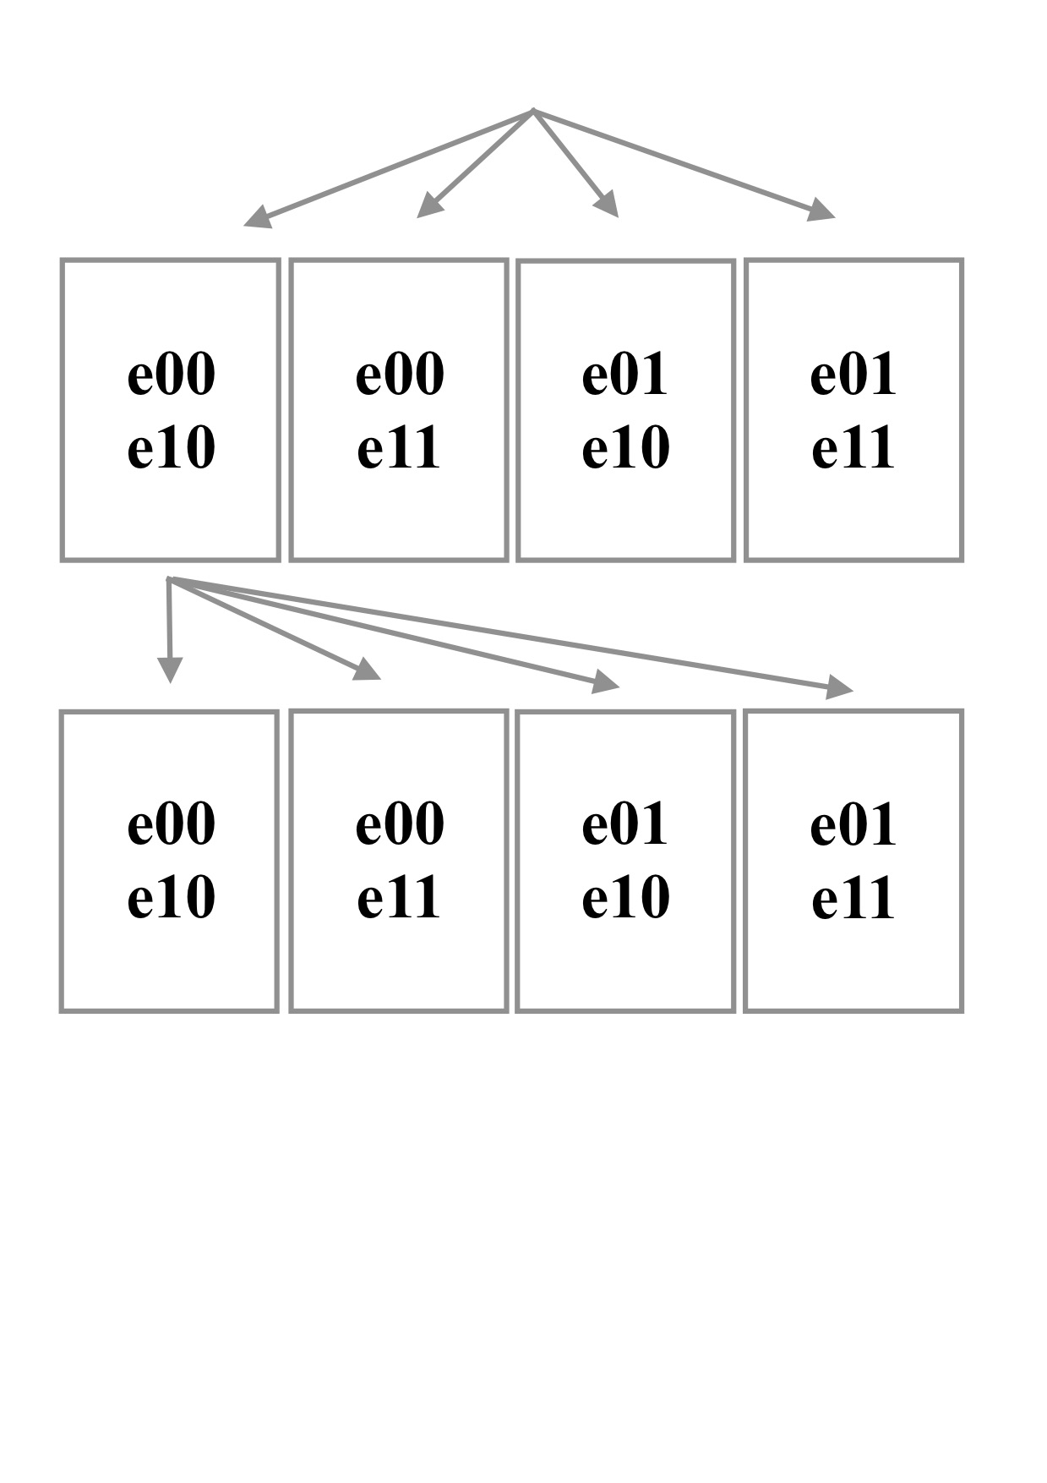
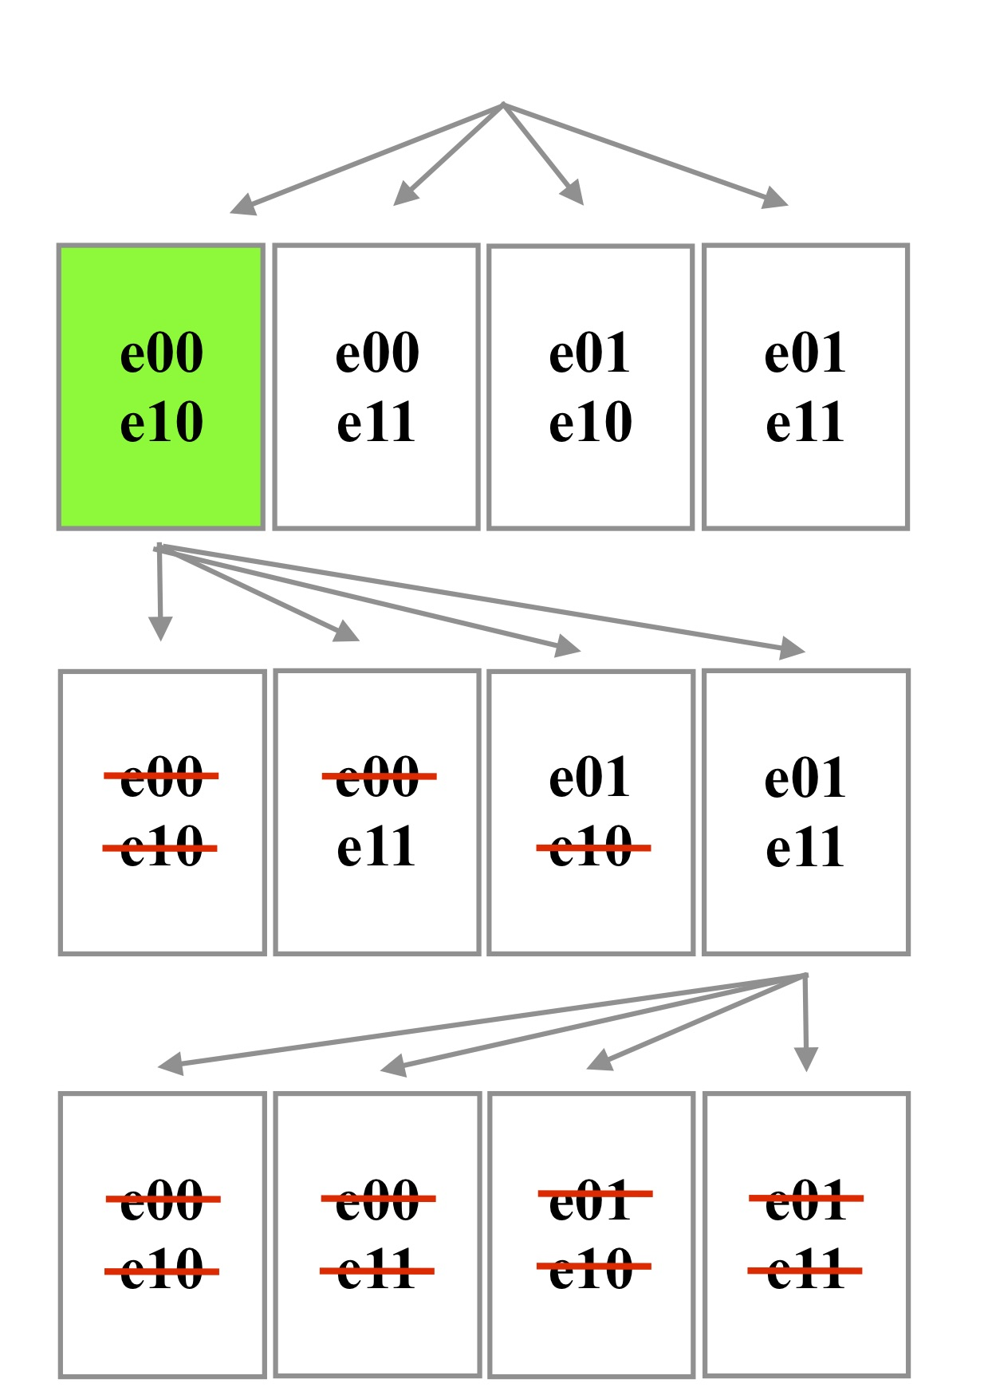
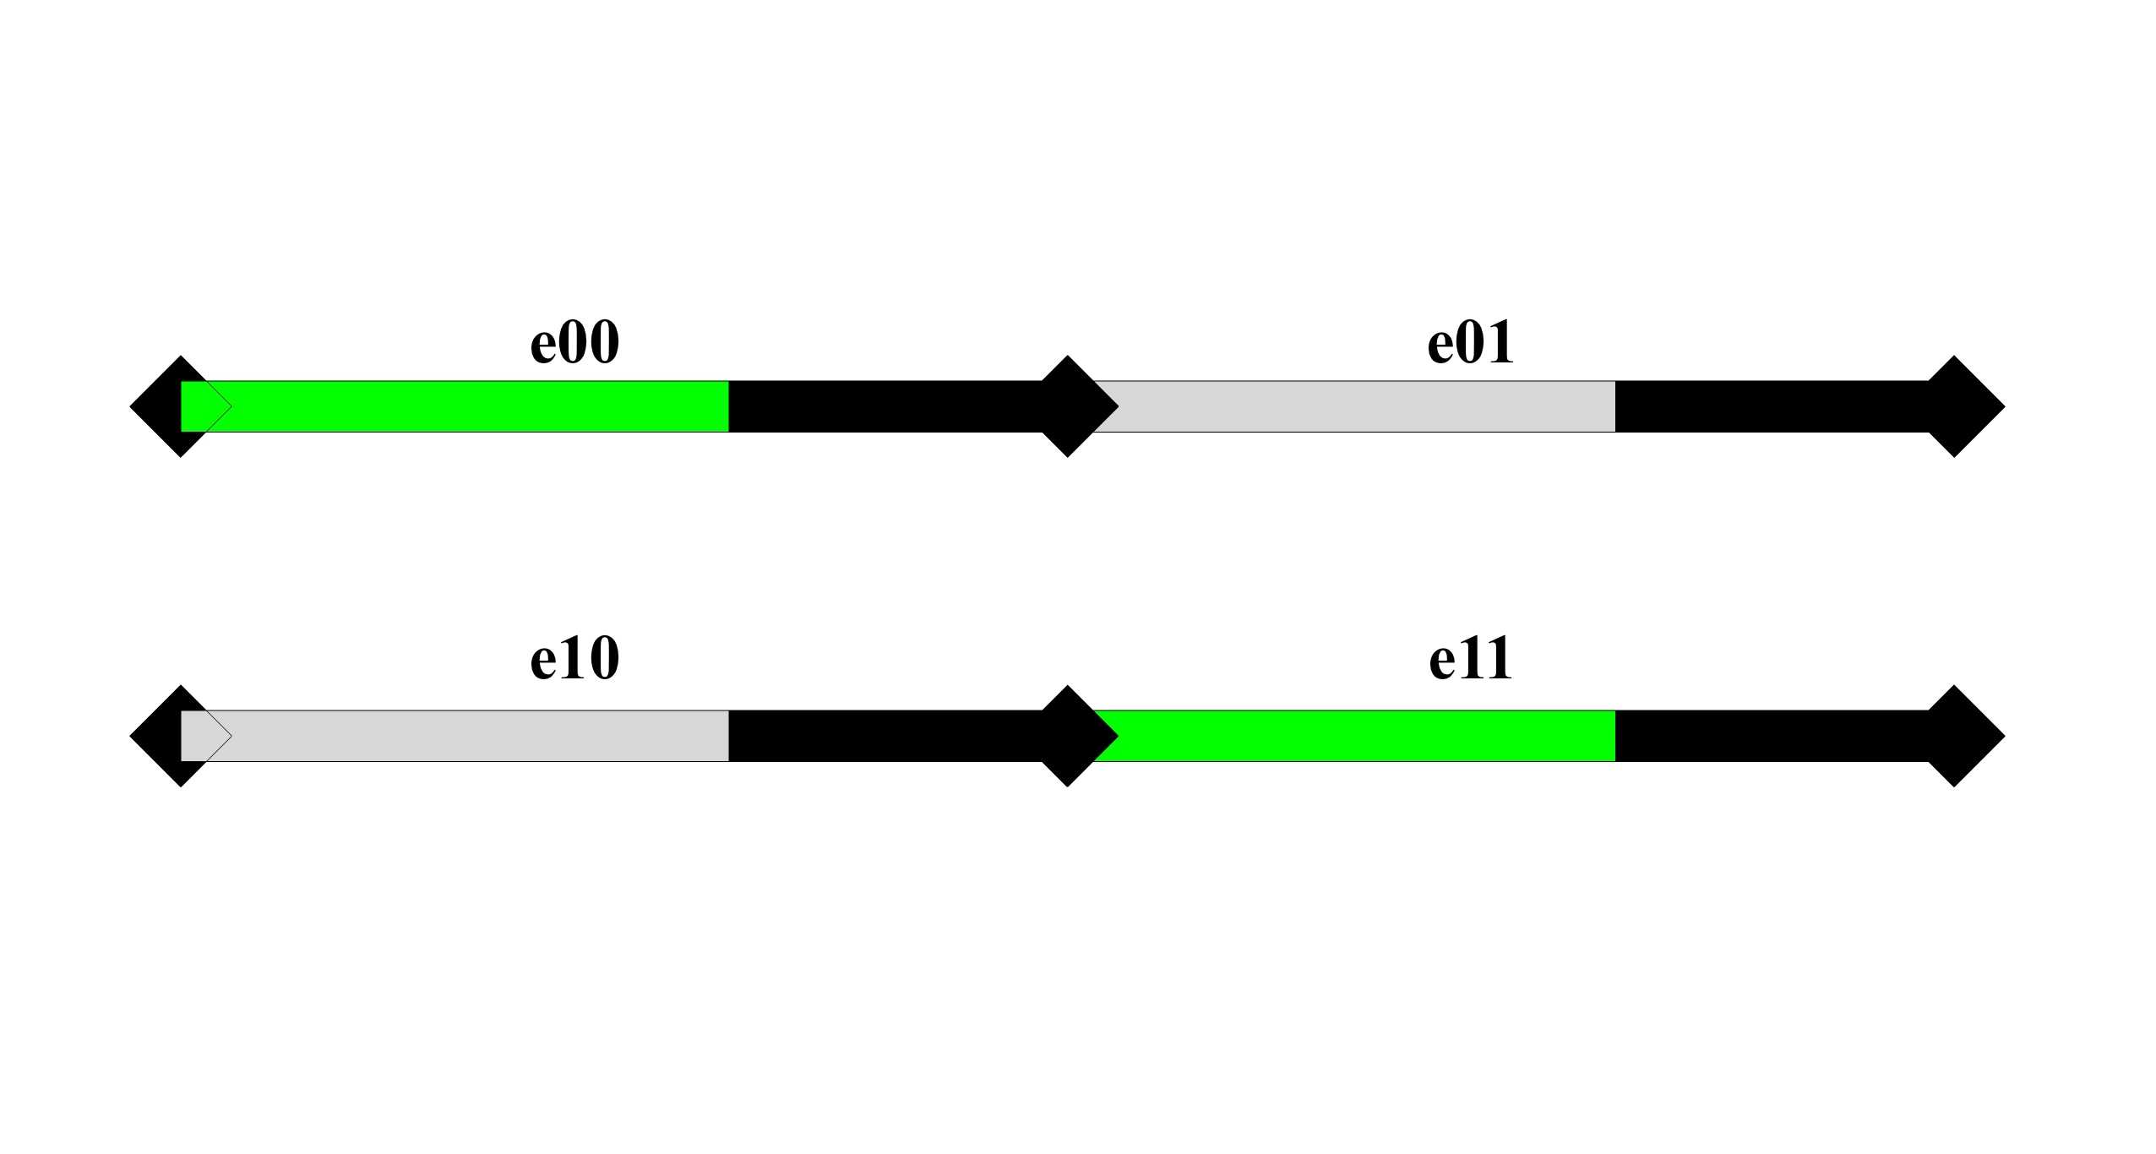
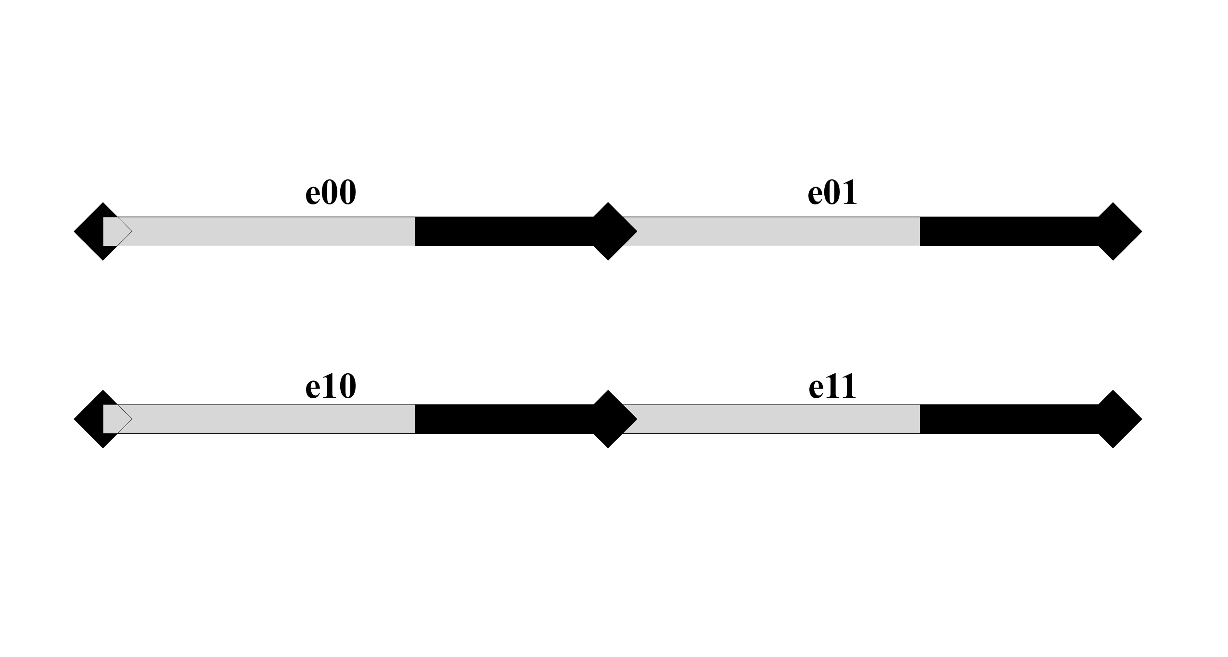
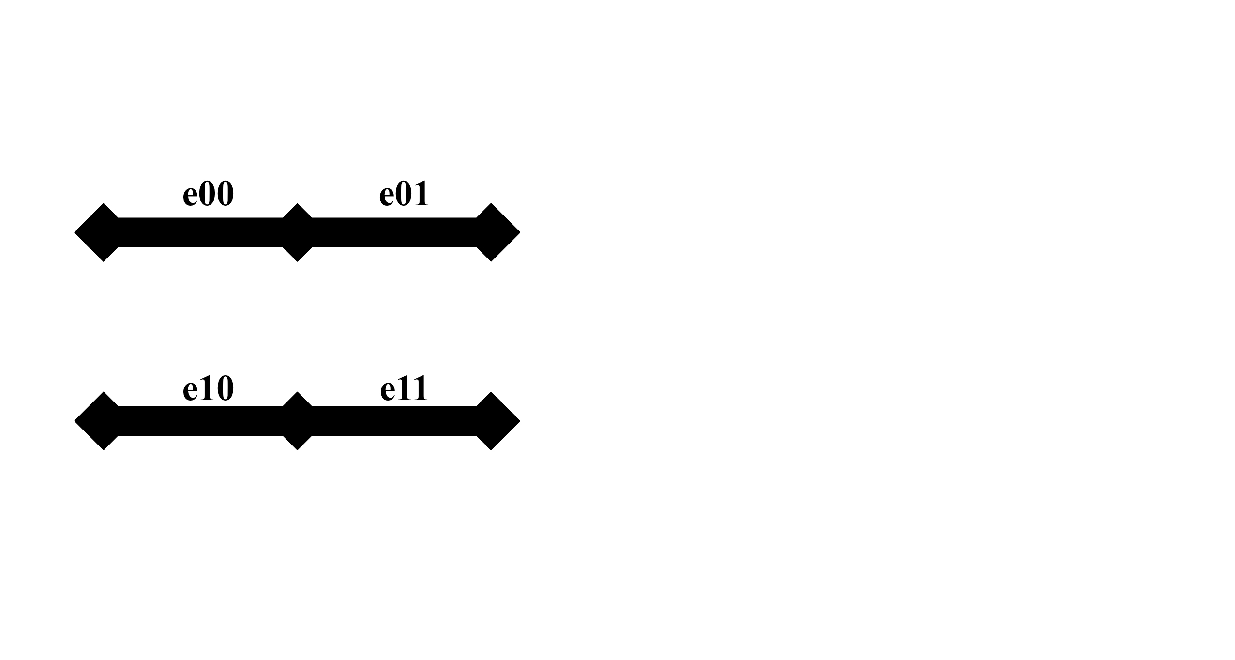
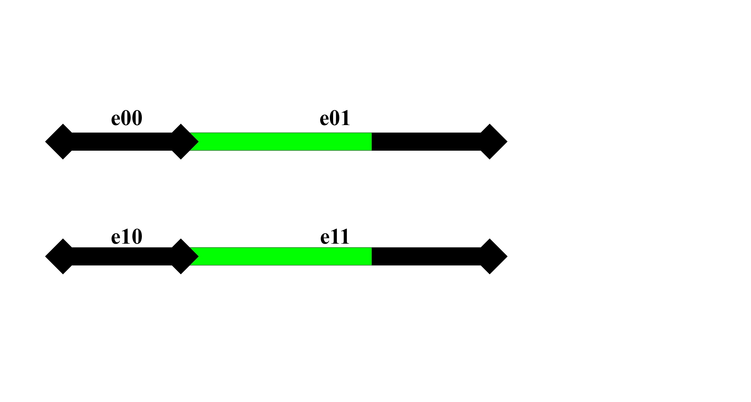
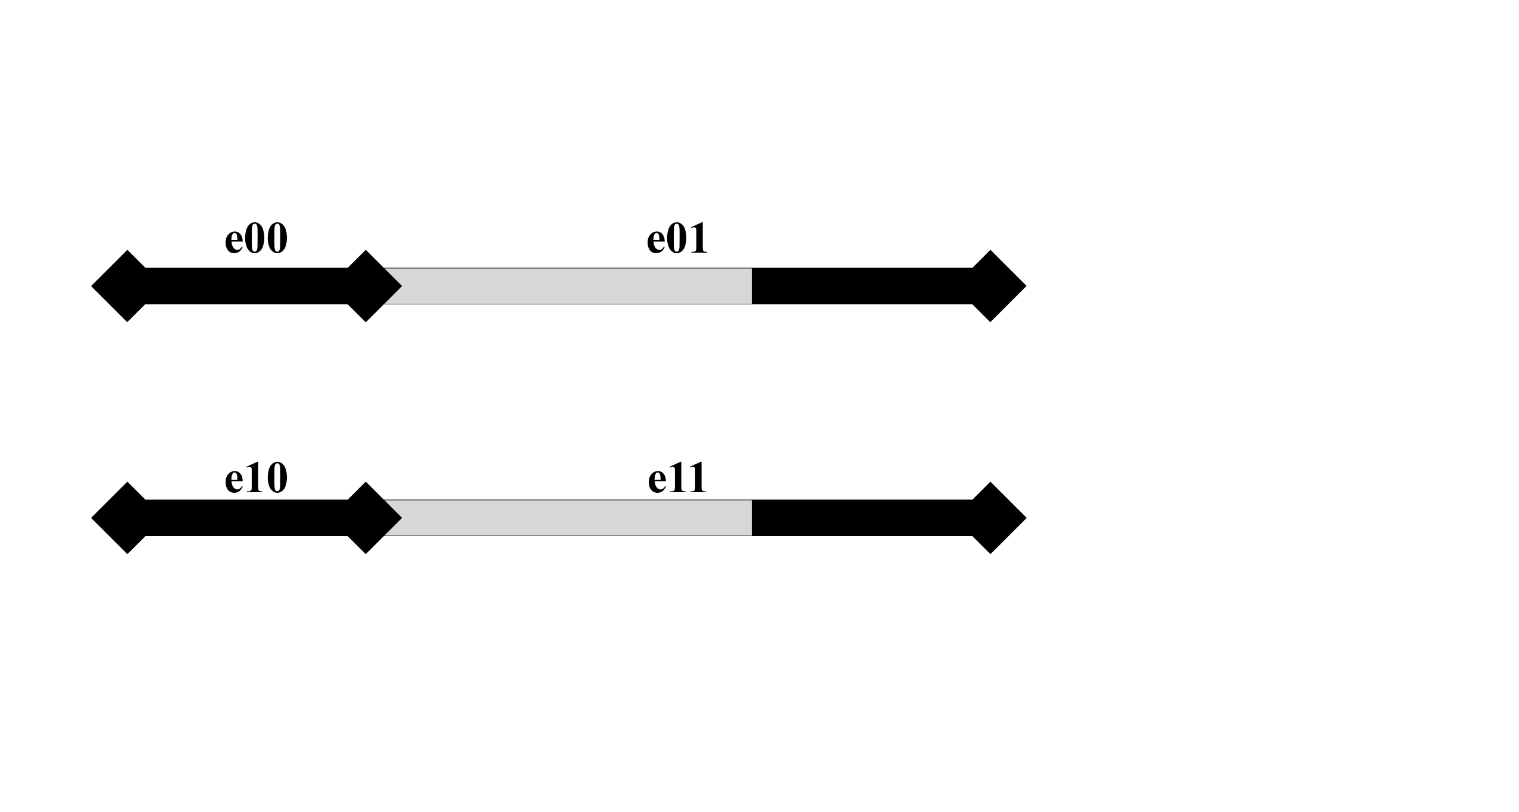
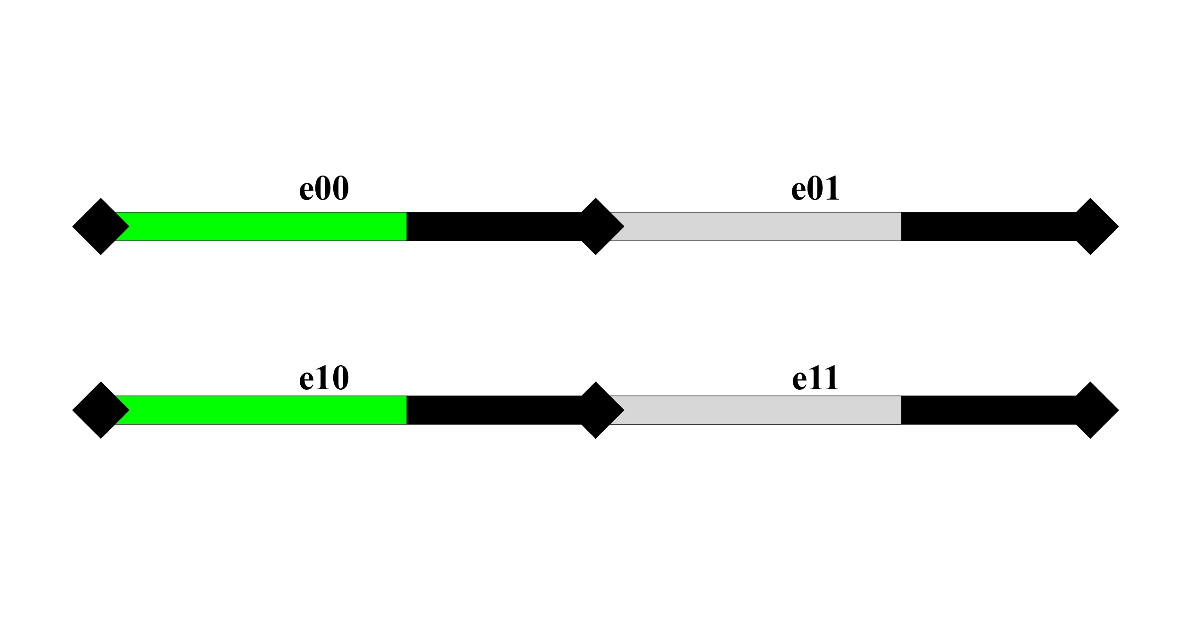
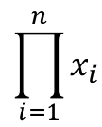
Step-wise recursive solver
Recursive stepwise method
$$\prod_{i=1}^{n}{x_{i}}$$

Slide 12
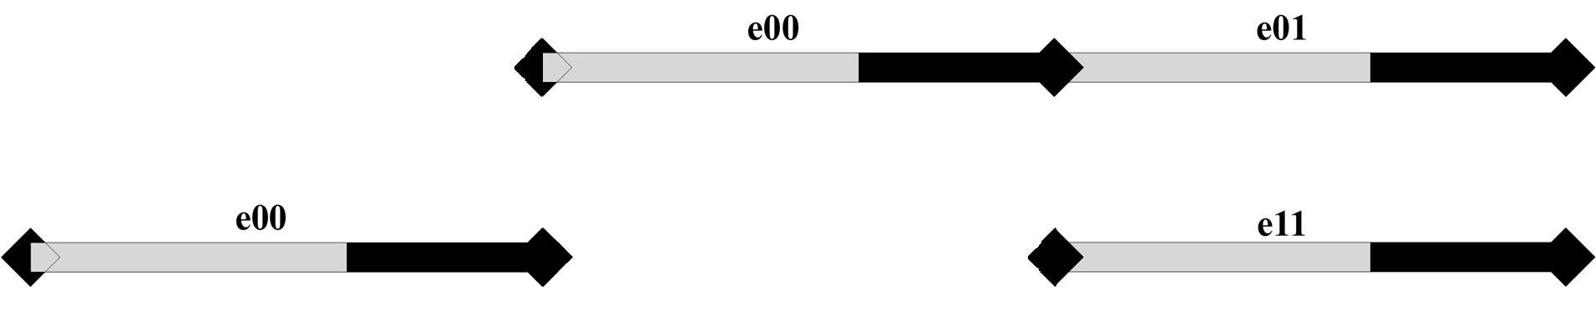
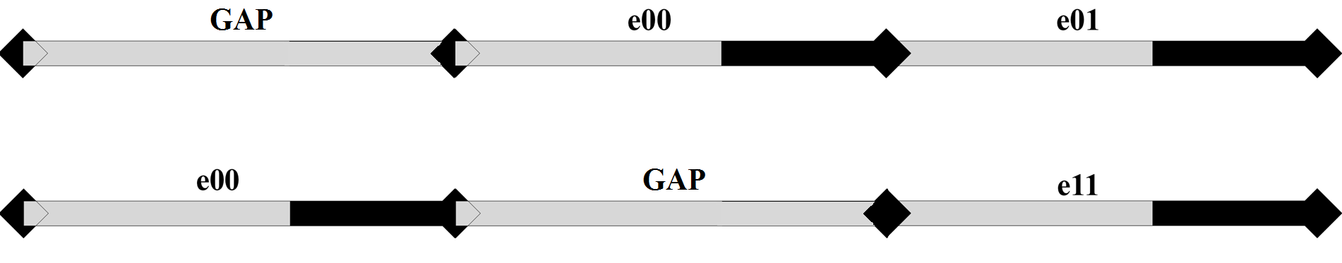
Step-wise recursive solver
Recursive stepwise method
The same idea can be applied to:
Gaps
Cross members
Add restrictions to the simultaneous deformation of multiple members

Slide 13
Progress status of task 3
Initial state – Deformation History interface
Features of the video generation code

Slide 14
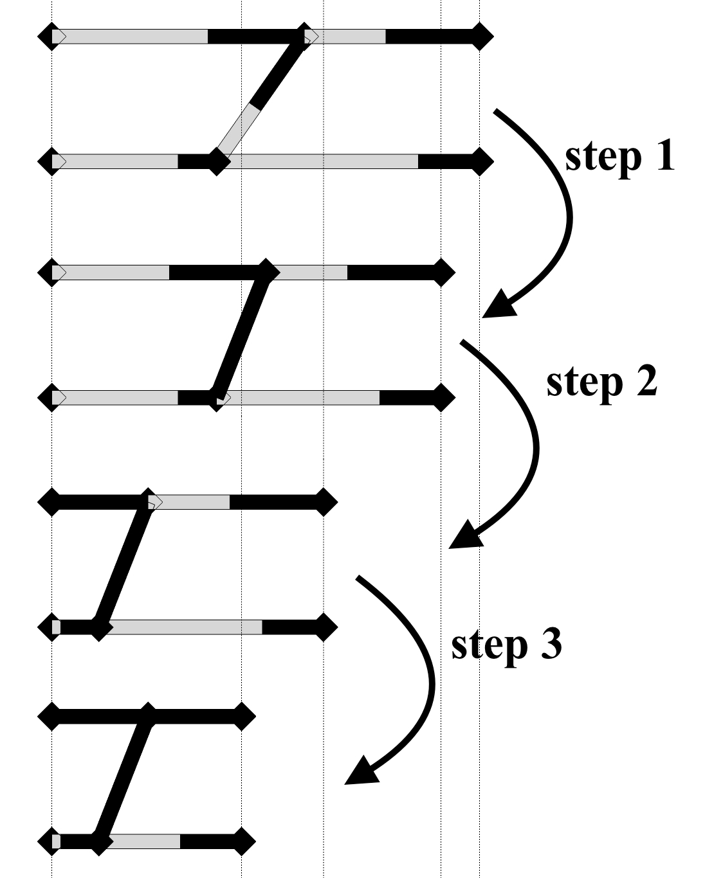
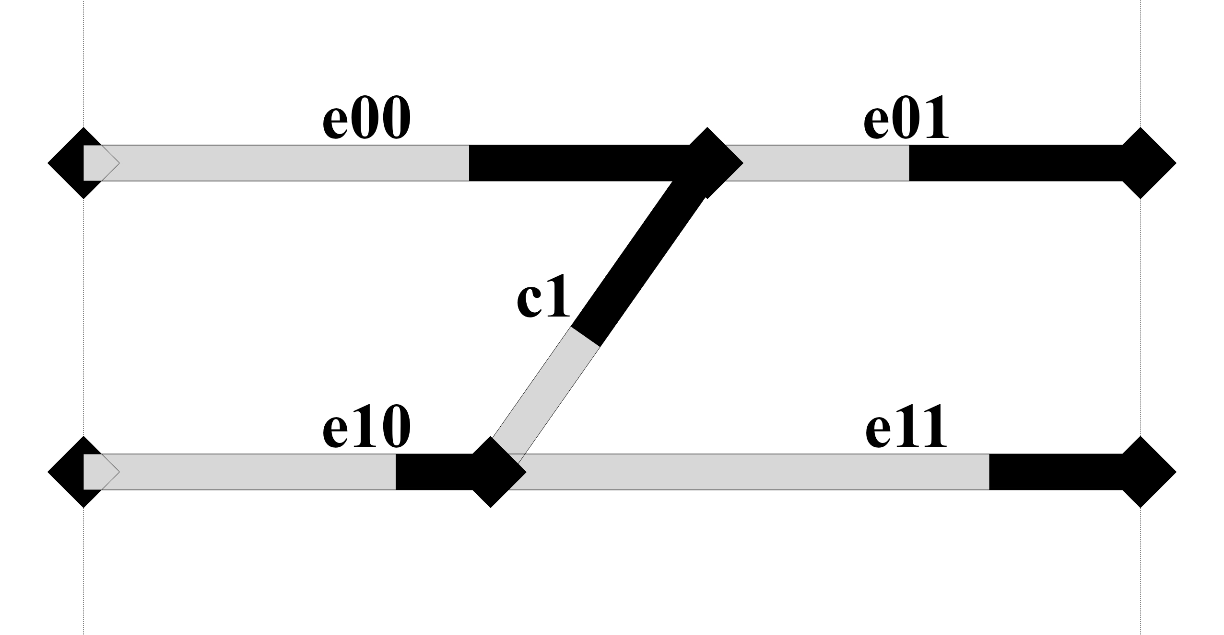
Initial state – Deformation History interface
Input
Initial State
Deformation History
Notes:
How to describe a solution?
When we joined the solver code with the animation code, we need to define a common way to describe the solution, so that the output of the solver could be directly used as an input for the video generation.
We decided to describe the movement of each component INDEPENDENTLY
The movement of each component is described by 2 data:
Initial state
Deformation history

Slide 15
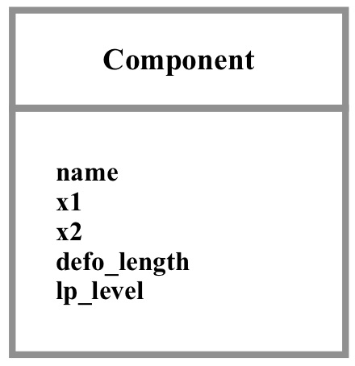
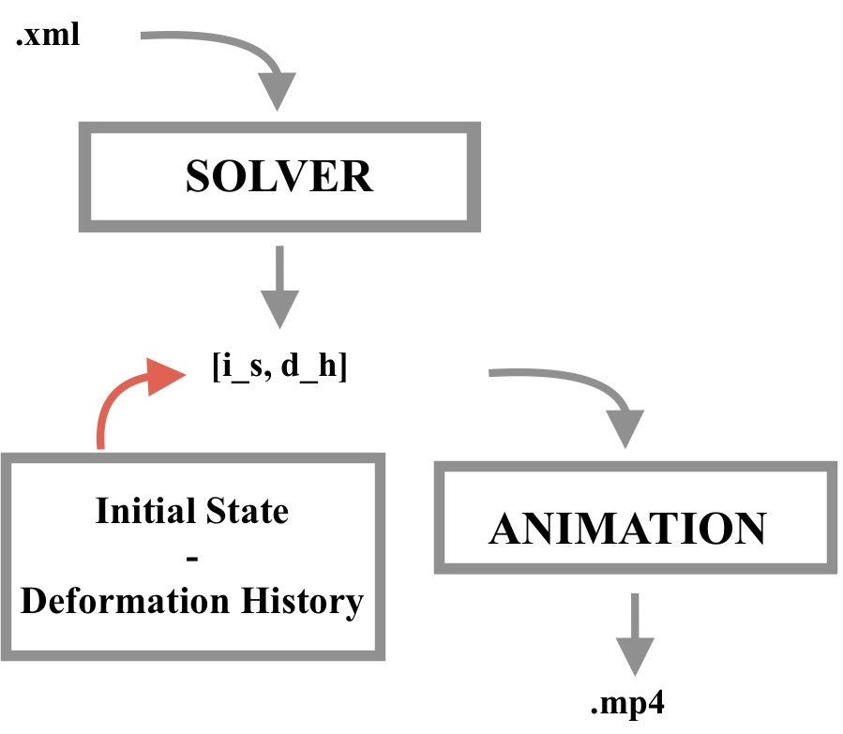
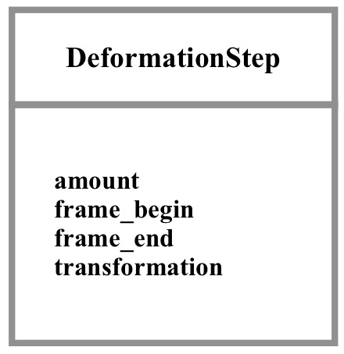
Initial state – Deformation History interface
Input
Notes:
These 2 data are saved into 2 classes
The initial state is saved in a class component
and is defined by the name of the component, the coordinate of the left node, …
The Deformation history is saved as a sequence of deformation steps:
Each deformation step is saved in a class created ad-hoc
And is defined by the amount, …

Slide 16
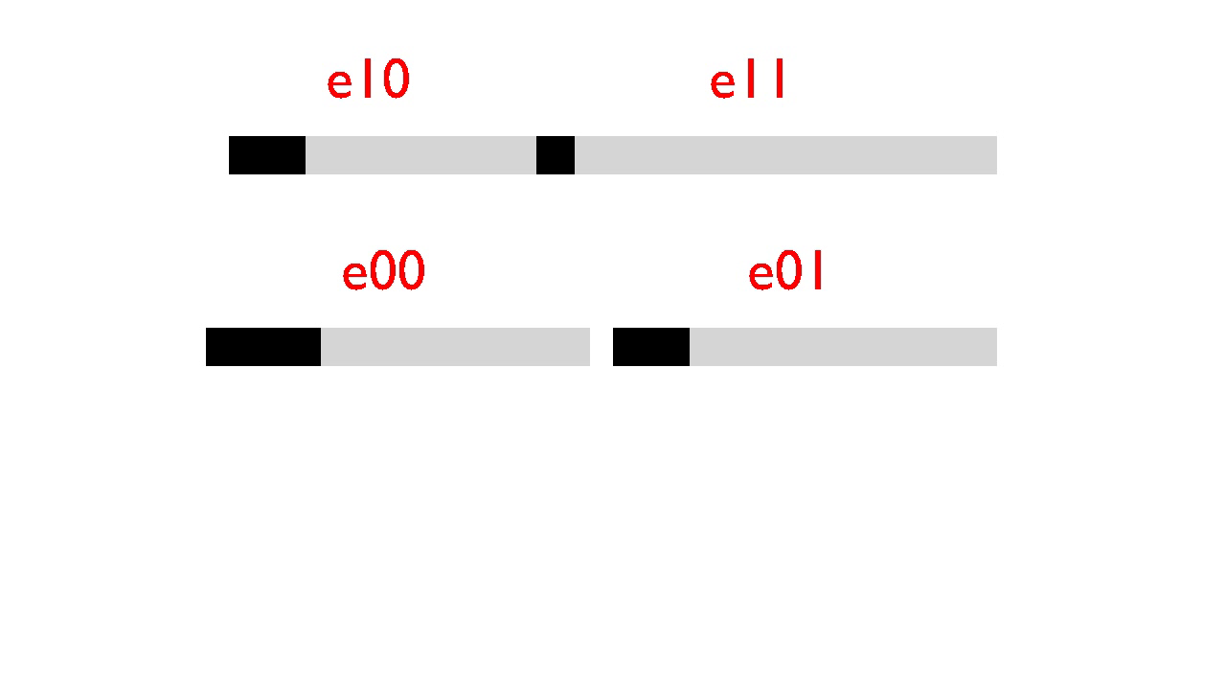
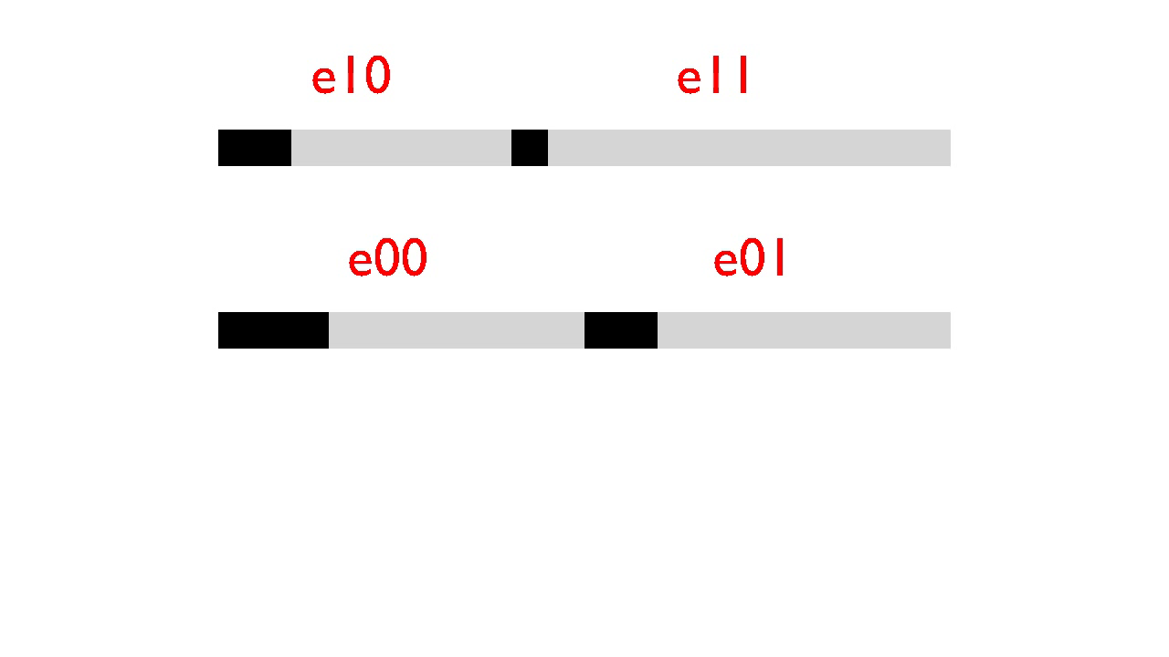
Translation and deformation
Initial state – Deformation History interface

Slide 17
Progress status of task 3
Initial state – Deformation History interface
Features of the video generation code

Slide 18

A general case
Features of the video generation code

Slide 19
Next steps
TASK 1
Directly select elements to deform
How to show the results to the user? (Other than a long list)
TASK 2
Solve TASK 2
TASK 3
Create videos with gaps and connections (without hardcoding the input)
Notes:
Implement a new way to look for members to deform, according to the new assumptions (TASK 1)
Implement gaps, rigid members (TASK 1)
Implement the possibility for the user to access the solutions in a way different from a long list (TASK 1)
Solve TASK 2

Slide 20
Thanks for your attention

Slide 21
Backup slides

Slide 22
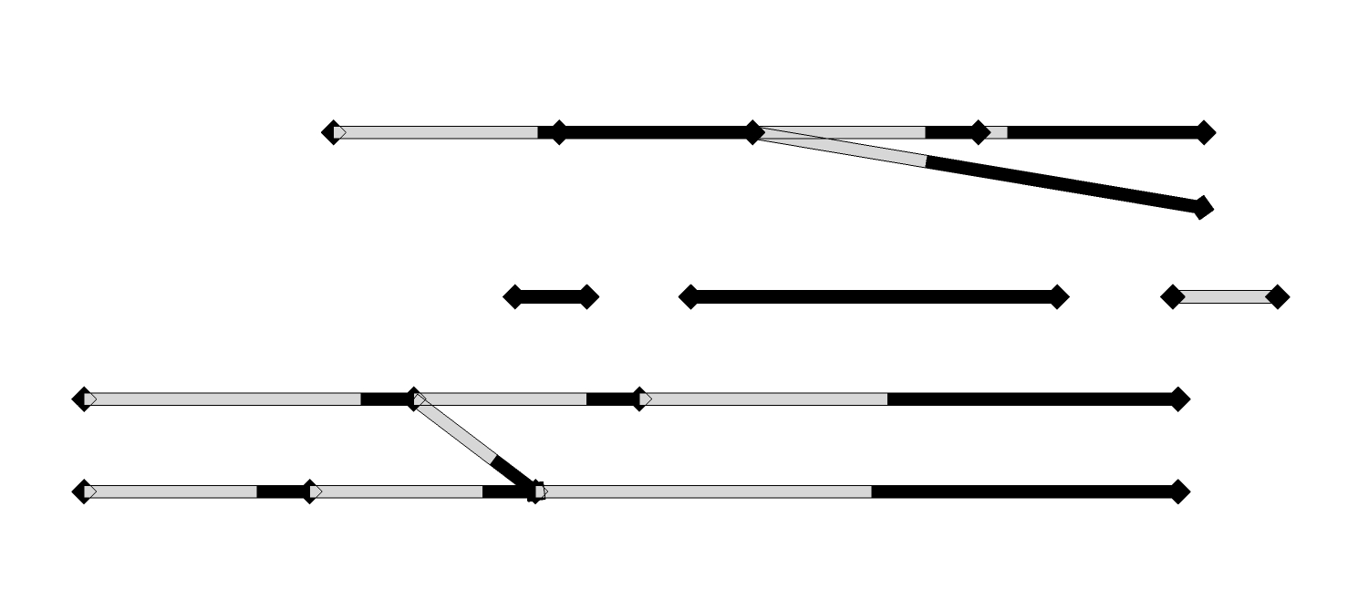
Independent loadpaths

Slide 23
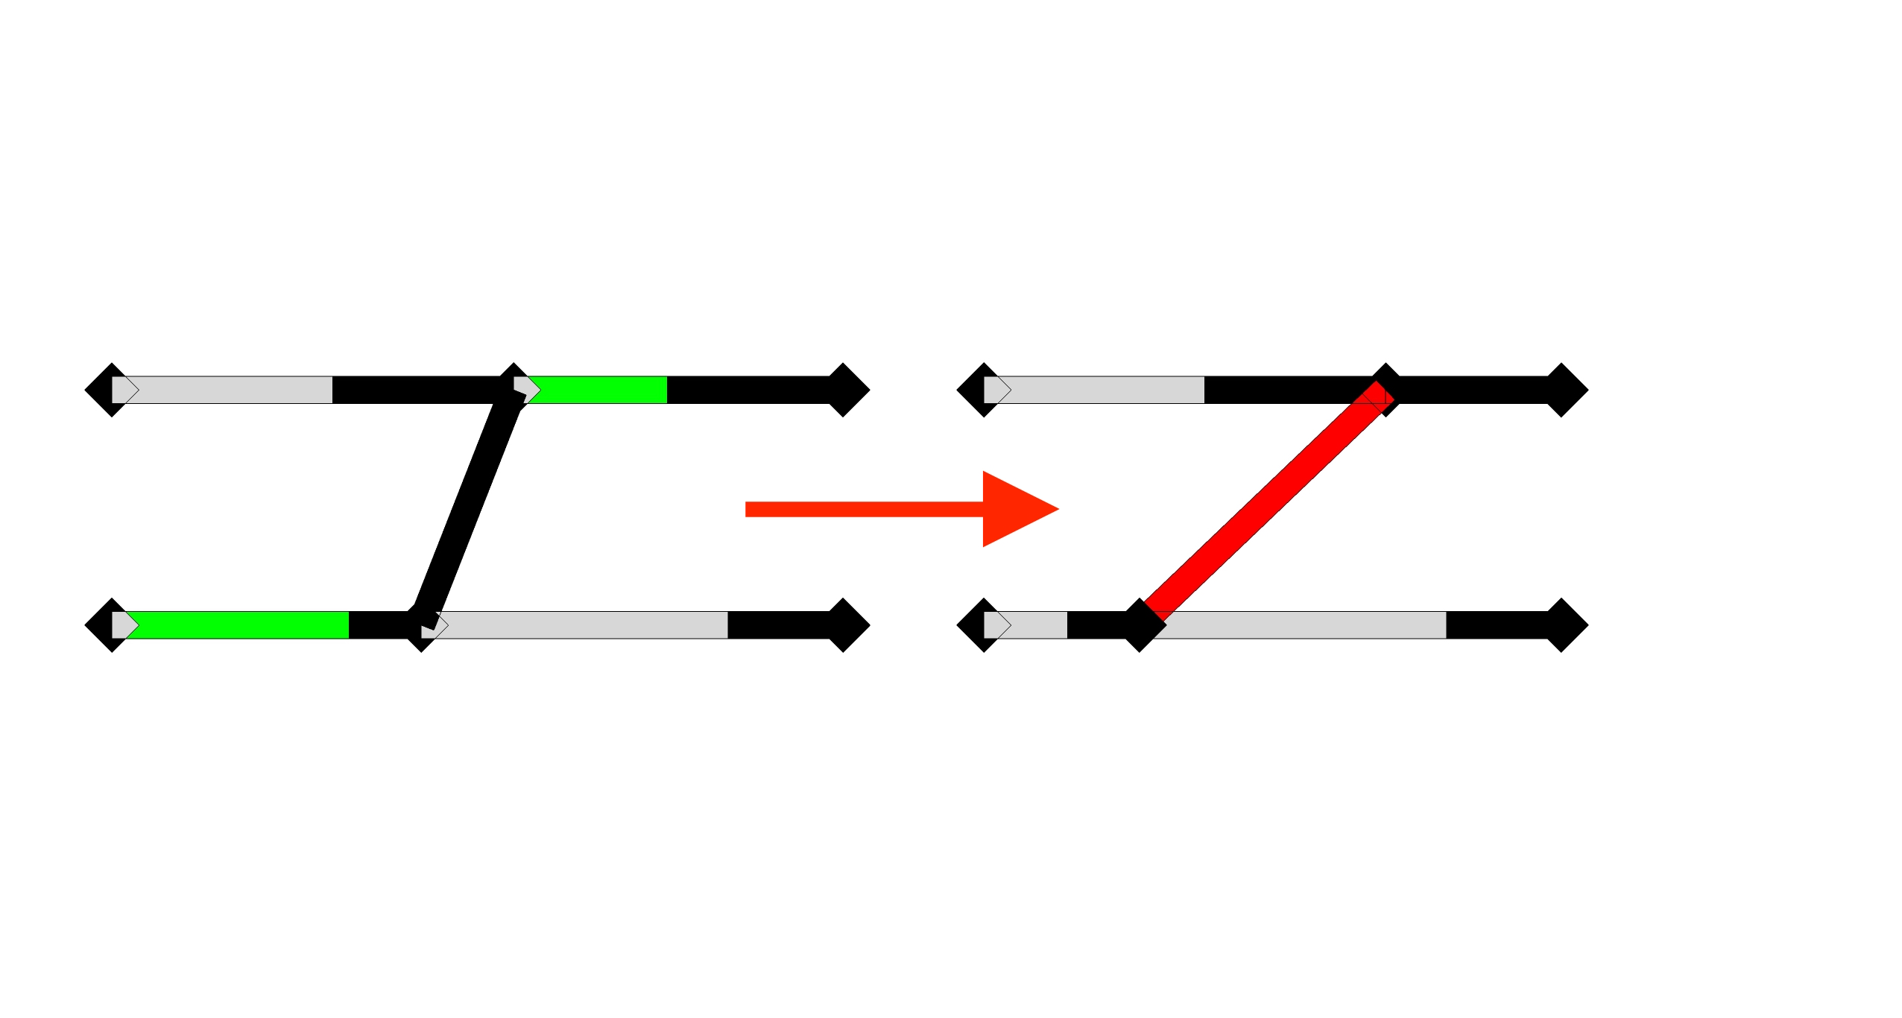
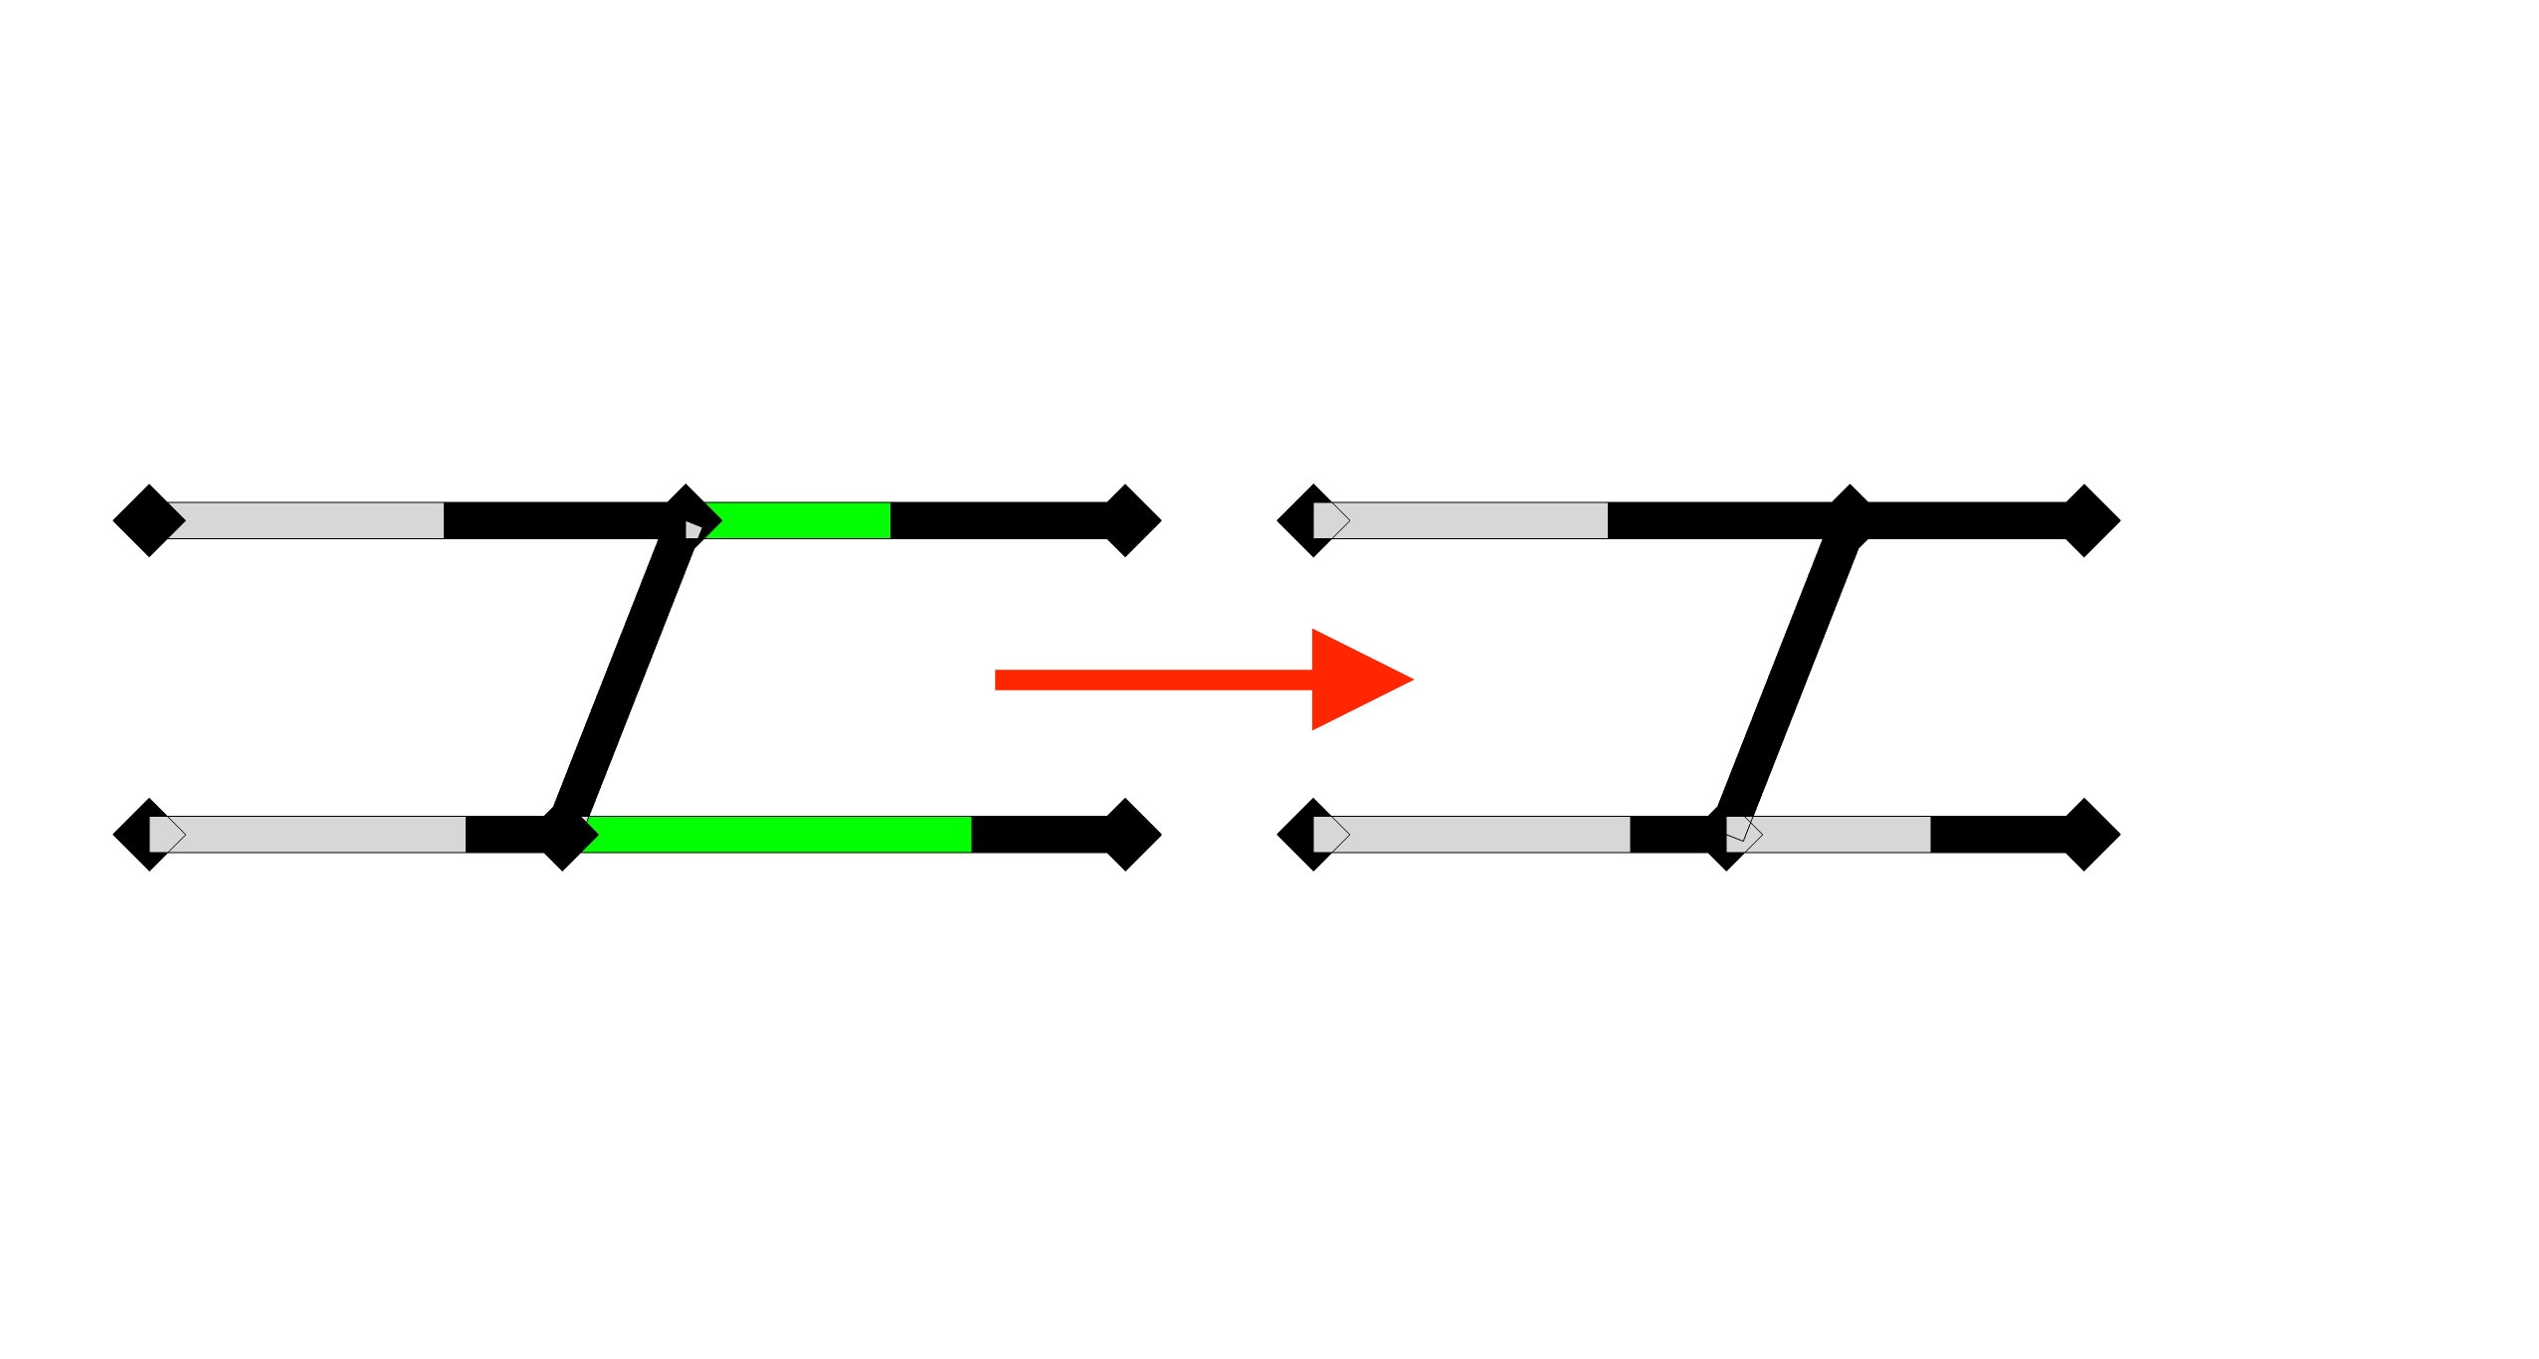
When did the previous assumptions fail?
New model assumptions IN DETAIL
New proposed assumptions
STEP 1:
STEP 1: PERFORMED
Let’s consider a simple structure
and a particular order of deformation
Allow connections to break
Keep connections intact and allow member to deform twice
STEP 2 ?
STEP 2: DEADLOCK
4th possibility:
Deforming the stiffer members
3rd possibility:
Deforming the rear part
2nd possibility:
Deforming the front part
1st possibility:
Keep on deforming the same members
There are 4 possibilities:
let’s try all of them

Slide 24
NEW VERSION (work in progress)
Exhaustive enumeration method
Pre-computing all the solutions is not so easy anymore, since components are allowed to deform more than once
Elements to deform have to be chosen directly:
How to choose them? How to ensure that all the solutions will be considered?
Reasons to choose a component | Reasons not to choose a component
deformable already successfully chosen in previous deformation step (the component is deforming) | rigid / completely deformed already unsuccessfully chosen in previous deformation step (that deformation step would be invalid ghost components

Slide 25

Ghost component

Slide 26
Initial state – Deformation History interface
Input
Notes:
These 2 data are saved into 2 classes
The initial state is saved in a class component
and is defined by the name of the component, the coordinate of the left node, …
The Deformation history is saved as a sequence of deformation steps:
Each deformation step is saved in a class created ad-hoc
And is defined by the amount, …

Slide 27
Initial state – Deformation History interface
Our package
i_s = [Component, Component, …]
d_h = [ {Component : [DeformationStep, DeformationStep, … ],
Component : [DeformationStep, DeformationStep , …],
…},
{Component : [DeformationStep, DeformationStep , …],
Component : [DeformationStep, DeformationStep , …],
…},
…
]
Notes:
Our code is divided into 3 sub-packages:
Solver
Isdh (which stands for Initial State …)
Animation
The solver takes an .xml file and outputs 2 lists
i_s for the initial state
D_h for the deformation history
Then these lists are passed to the animation that outputs a video
––––––– RUN ANIMATION ––––––––
The i_s list is a list of components as defined before
The d_h list is a list of dictionaries. Each dictionary corresponds to a solution.
Whitin each dictionary a list of deformation steps is associated to its component

